Slide 1

WING DESIGN
AESP 415 – Aircraft Design Part I Basics
Lecture 11-16
MODULE
4
TOPIC 8
Dr. Wout De Backer
1000 Catawba St, Ste 120
wdbacker@cec.sc.edu

Slide 2
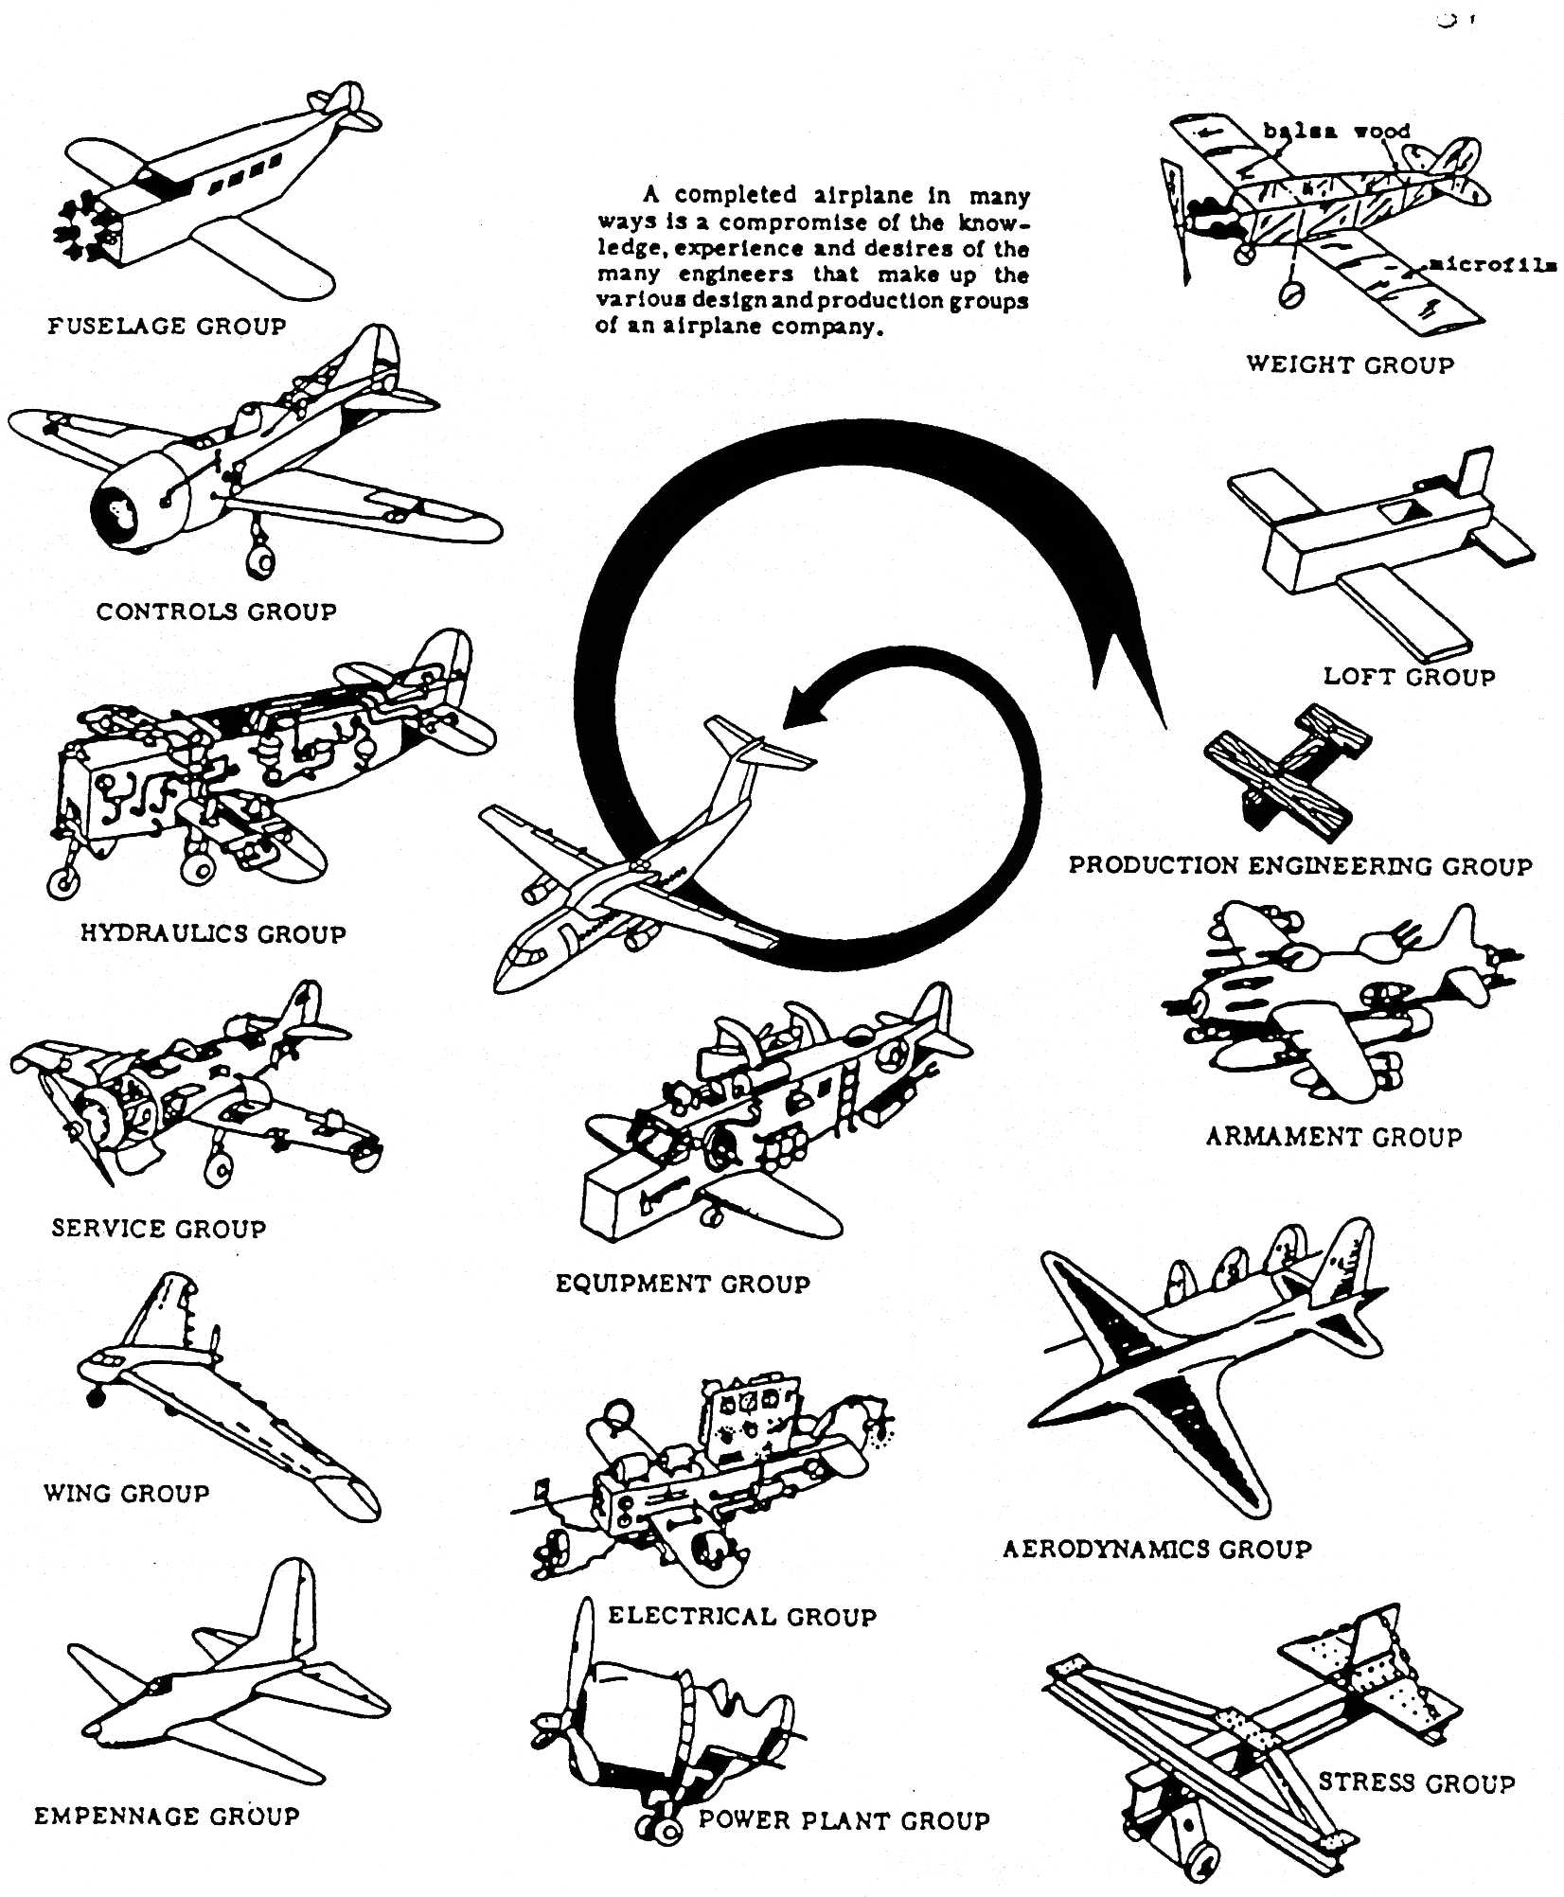
Lecture Contents
Wing Sizing
8.1. Introduction to Wing Design
8.2. Infinite Wings & Airfoils
8.2.1 Characterization and Performance
8.2.2 Selection Procedure
8.3. Finite Wings
8.3.1 Planform Parameters
8.3.2 Effect and selection of wing design parameters
8.3.3 Lift curve for finite wings
8.4. High Lift Devices
8.4.1 Trailing-Edge Devices
8.4.2 Leading-Edge Devices
8.5. Other Considerations
8.5.1 Wing Fuel Tanks
8.5.2 Integration of Wing Structures
8.6. Wing Design Checklist
Notes:
Contents from this slide deck is sourced and adapted from Aircraft Design 1 Course. Content by Dr. Joris Melkert from Delft, University of Technology

Slide 3
Are you on track for this course?
Have you calculated/verified the OEW, Mission Fuel Weight and MTOW?
Have you completed the class 1 weight estimation?
Have you started the T/W – W/S diagram (Stall/Take-off)?
Have you started the T/W – W/S diagram (Landing/Drag Polar)?
Have you started looking at reference engines?
Notes:
For part 1

Slide 4
Are you on track for this course?
Have you started the T/W – W/S diagram (Stall/Take-off)?
Have you started the T/W – W/S diagram (Landing/Drag Polar)?
Have you started looking at reference engines?
Have you started the T/W – W/S diagram (Climb Rate/Climb Gradient)?
Have you started the engine selection and scaling?
Have you started the report writing for assignment 2 (due soon!)?
Notes:
For part 2

Slide 5
Are you on track for this course?
Have you completed the T/W – W/S diagram (Climb Rate/Climb Gradient)?
Have you completed the engine selection and scaling?
Have you started the report writing for assignment 2 (due soon!)?
Have you updated your engine CAD for assignment 2?
Did you review what is needed for assignment 3?
Notes:
For part 3

Slide 6
Are you on track for this course?
Did you submit assignment 2?
Did you review what is needed for assignment 3?
Have you reviewed the airfoil selection slides?
Have you started calculating the Re and C_{l,des} and look for airfoils?
Have you familiarized yourself with airfoil tools?
Notes:
For part 4

Slide 7
Are you on track for this course?
Did you review what is needed for assignment 3?
Have you reviewed the airfoil selection slides and selected an airfoil?
Have you familiarized yourself with airfoil tools?
Have you calculated the Re and C_{l,des} , S, b, and other parameters for a clean wing?
Have you calculated and located your MAC?
Have you updated your clean wing CAD for assignment 3?
Notes:
For part 5

Slide 8
Lecture Contents
Wing Sizing
8.1. Introduction to Wing Design
8.2. Infinite Wings & Airfoils
8.2.1 Characterization and Performance
8.2.2 Selection Procedure
8.3. Finite Wings
8.3.1 Planform Parameters
8.3.2 Effect and selection of wing design parameters
8.3.3 Lift curve for finite wings
8.4. High Lift Devices
8.4.1 Trailing-Edge Devices
8.4.2 Leading-Edge Devices
8.5. Other Considerations
8.5.1 Wing Fuel Tanks
8.5.2 Integration of Wing Structures
8.6. Wing Design Checklist
Notes:
Contents from this slide deck is sourced and adapted from Aircraft Design 1 Course. Content by Dr. Joris Melkert from Delft, University of Technology

Slide 9

8.1 Introduction
What are the main functionalities an aircraft wing must provide?
Satisfy the required flight characteristics* during all the operational phases
(i.e., when flying at different speed, altitude, temperature, weight and power setting)
This is more than just “generate lift”! It is more about the way lift is generated (e.g., the distribution of pressure loads on the wing) and the amount of lift that is generated in relation to drag.
Provide accommodation for structure
Provide room for fuel storage
Some aircraft, such as gliders, can use wing as storage for water.
Certain amphibians aircraft use wings as source of buoyancy and/or to provide stability on the water.
Provide accommodation/attachment for engines, landing gears, etc.
Other? (carrying mission-specific payloads?)
Notes:
While the first two functional requirements are generally common to any wing design, the others are just optional: not all kind of aircraft use wings to store fuel, not all aircraft have landing gears attached to the wing.

Slide 10
8.1 Introduction
The main objectives to be achieved in the design of a wing are aerodynamic and performance-related objectives:
High lift gradient (C_{Lα})
High maximum lift coefficient C_{Lmax}
Low drag
Low stall speed
Good stall behaviour
High cruise speed
Good climbing characteristics
Good manoeuvrability
…
Some of these goals are actually conflicting:
A large wing allow a low stall speed, but it is generally not good for high speed.
A wing designed to generate a lot of lift, is generally not the best concerning drag.
Design objectives vary for different operational phases and flight conditions (cruise vs. landing/take-off).
Aerodynamics and performance objectives are not the only ones to be pursued in the design of a wing….

Slide 11
8.1 Introduction
Other objectives to be achieved in the design of a wing are Structure-related:
Low weight
Strength
Stiffness
Durability
…
Also in this case, objectives can be incompatible
A very strong wing is generally not the lightest…
Structural objectives are generally incompatible aerodynamics and performance objectives.
A thin wing can allow lower drag, but it will be heavier
Increasing the aspect ratio of a wing can lower induced drag, but a longer wing is generally heavier.
Notes:
Even if we presented weight, strength, stiffness, etc., as possible design objectives, generally the real objective is one, whereas the others are constrains. E.g., design the minimum weight wing, which has the minimum strength of … and the minimum stiffness value of… (the same comment applies for the aerodynamics and performance objectives)

Slide 12
8.1 Introduction
Other objectives to be achieved in the design of a wing:
Large fuel capacity
Manufacturability
Maintainability
…
It is usually not possible to design a wing that is able to meet all the most ambitious objectives!
Again, conflicting objectives can exist:
Fuel tank volume vs wing thickness (high speed performance)
Fuel tank volume vs. high lift device size (low speed performance)
It is designers’ job to prioritize the various objectives according to the top-level requirements and constraints posed by customer and regulations. Again, design is all about finding the best compromise

Slide 13

8.1 Introduction
What are the available wing design parameters?
The airfoils* (i.e., the airfoil parameters: t/c, c…)
The planform
The wing surface
The aspect ratio
The chords length
The taper ratio
The sweep angle
The twist angle
The incidence angle
The dihedral angle
…
Notes:
An airfoil is not exactly a parameter, unless we consider the airfoil NAME as parameter. Various parameters are required to define an airfoil. The amount and type of these parameters varies according to the way an airfoil is defined. E.g., thickness ratio, chord length, camber and nose radius are some of the parameters from the classical definition of airfoil (see coming slides).
Without entering in details, you should be aware that other definitions of airfoil exist, which might be more convenient than the classical one for the purpose, of wing shape optimization, for example. In this case an airfoil can be conveniently defined as a polynomial function, whose coefficients are the parameters available to modify the airfoil shape. Modifying one of these coefficients might affect more than one of the classical definition parameters.
For the scope of this course, it will be sufficient to get acquainted with the classical definition of airfoil and understand how to manipulate the relative parameters to affect the airfoil shape/performance.
In the list above, there are no “pure” structure parameters, such as skin thickness, number of spars and ribs, etc. The design of the wing structure is out of the scope of this course. However, the parameters above have definitely an impact on the weight of the aircraft, an other characteristics (apparently) not directly related with aerodynamics and flight performance. The wing span, the sweep angle, the root airfoil thickness ratio have a clear impact on the structural design of the wing.

Slide 14


8.1 Introduction
Learning goals:
Understand the effect of each parameter on the design of wing
Understand the interrelations between the various design parameters
Be able to select the right combination of parameters to design the wing that best complies with set goals and requirements
Notes:
Source: the hangover movie

Slide 15
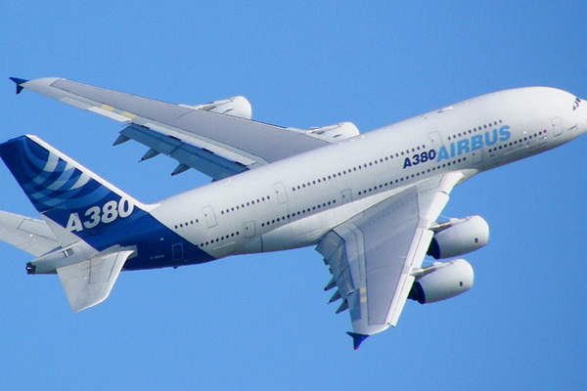
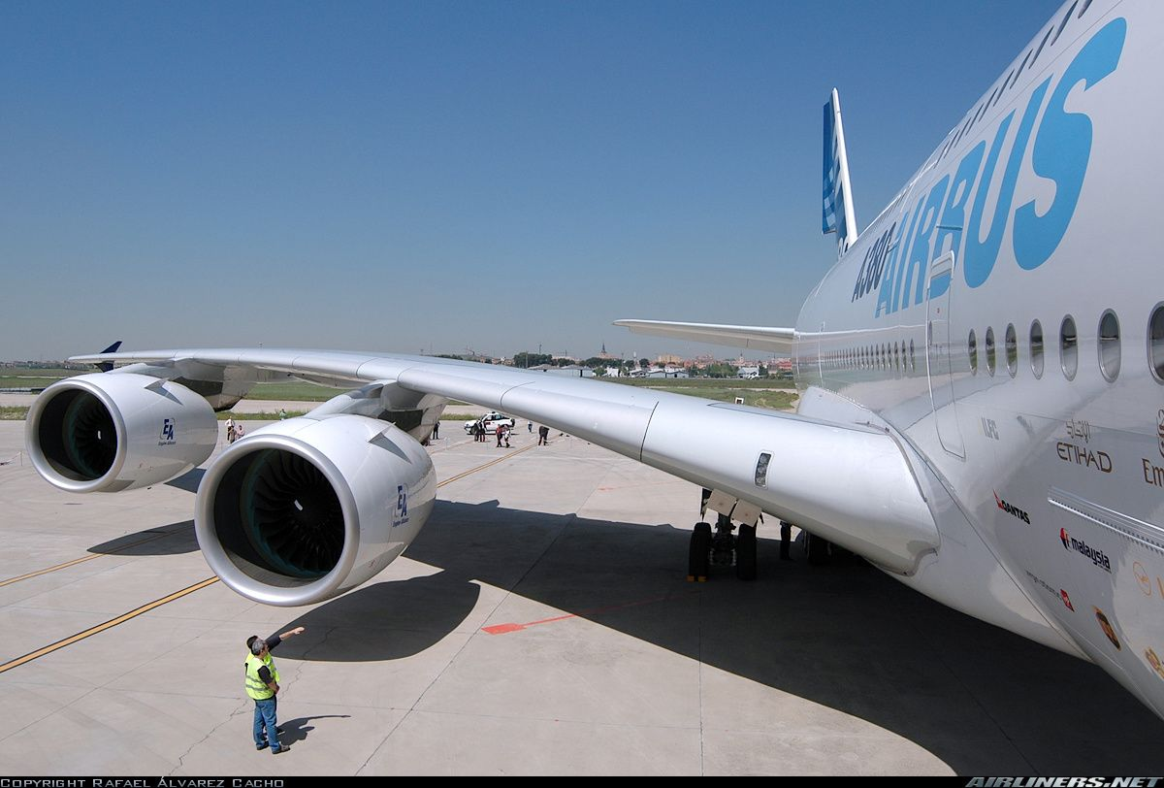
Wing Sizing & Design
Notes:
Sources:
https://i.pinimg.com/originals/42/c5/79/42c5792b342ee70210968a1060610619.jpg
https://www.aerospace-technology.com/wp-content/uploads/image-digitalinsightresearch/Archive/nri/aerospace/features/Aircraft%20with%20the%20longest%20wings/3l-Airbus-A380.jpg

Slide 16
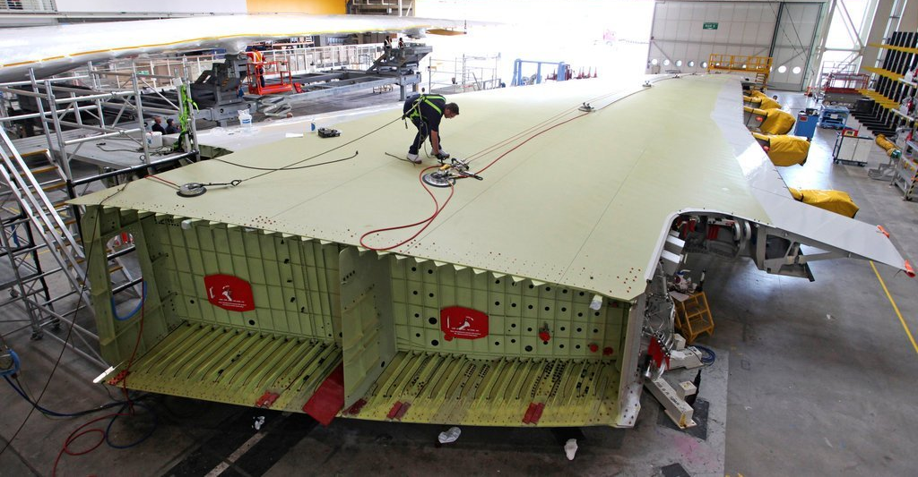
Wing Sizing & Design
Notes:
https://i.redd.it/9d2wjrxq1dv11.jpg

Slide 17
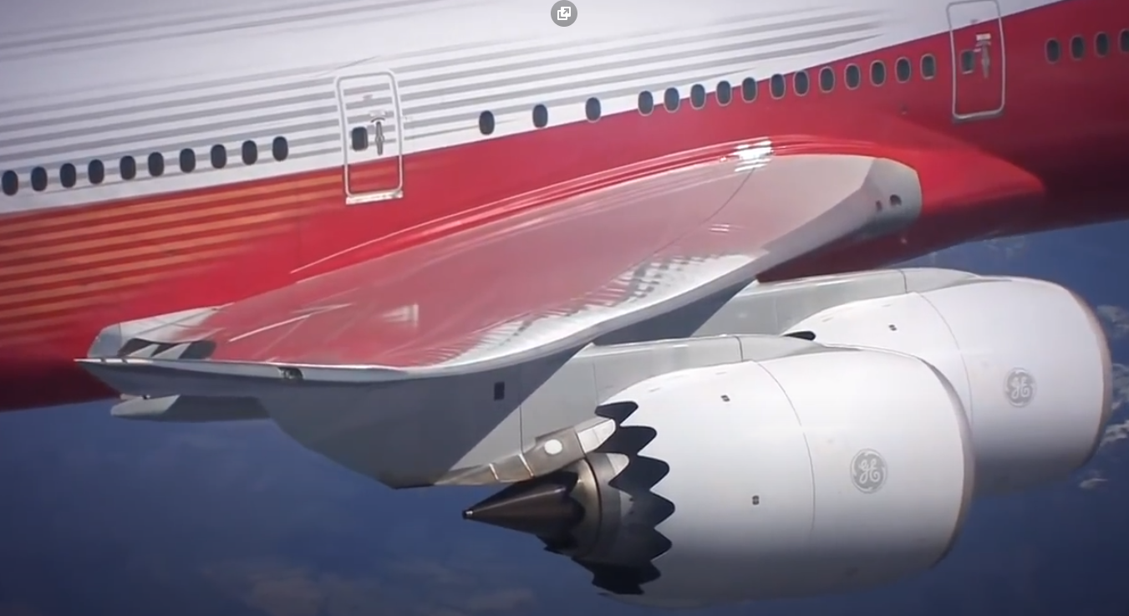
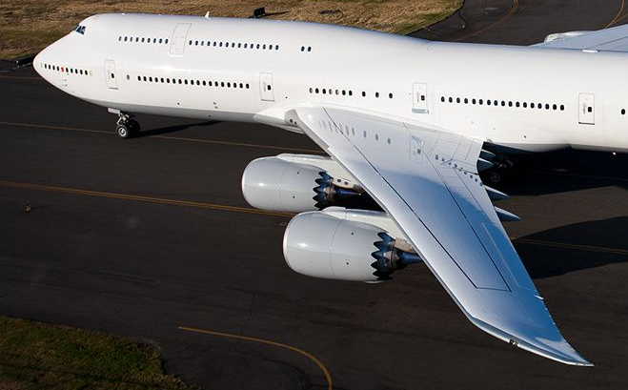
Wing Sizing & Design
Notes:
https://i.pinimg.com/originals/49/0d/dd/490ddd500be0b45c4e609ac9110b121c.jpg
https://www.google.com/url?sa=i&url=https%3A%2F%2Fwww.youtube.com%2Fwatch%3Fv%3DxGe7YLxU3KE&psig=AOvVaw12ZlgIgPlyTOkqNRUr6fZ2&ust=1601434326535000&source=images&cd=vfe&ved=0CAMQjB1qFwoTCPCa-fatjewCFQAAAAAdAAAAABAO

Slide 18
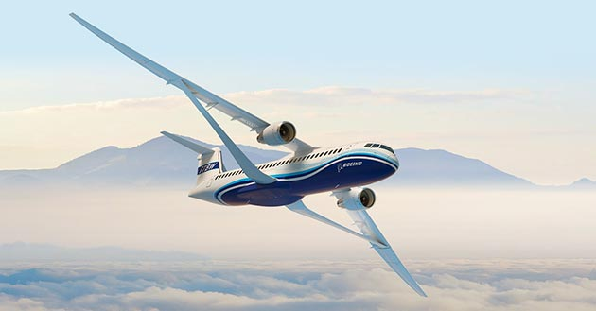

Wing Sizing & Design
Notes:
https://i2.wp.com/thepointsguy.com/wp-content/uploads/2019/01/boeing-transonic-spreading-wings_630x329.jpg?fit=1024%2C1024px&ssl=1
https://cdn.arstechnica.net/wp-content/uploads/2019/06/KLM-en-TU-Delft-vliegen-in-een-v-om-brandstof-te-besparen.jpg

Slide 19
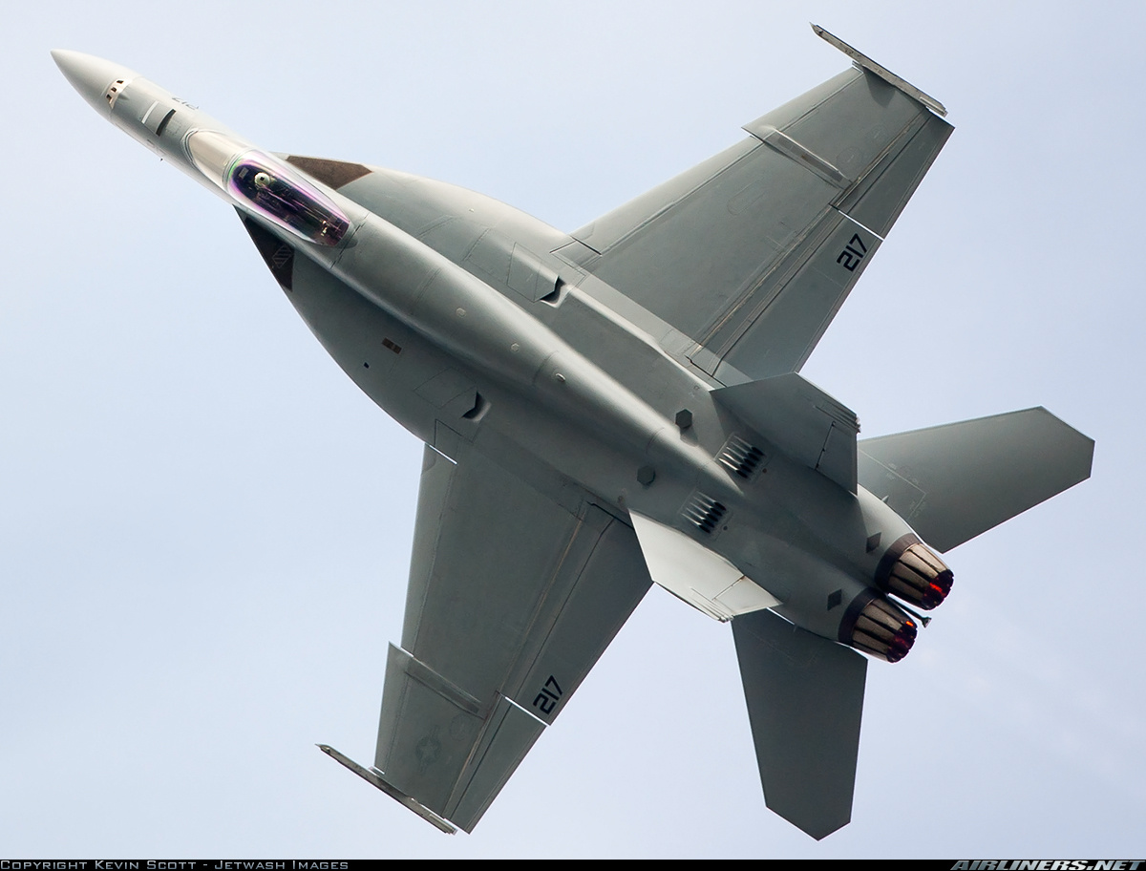
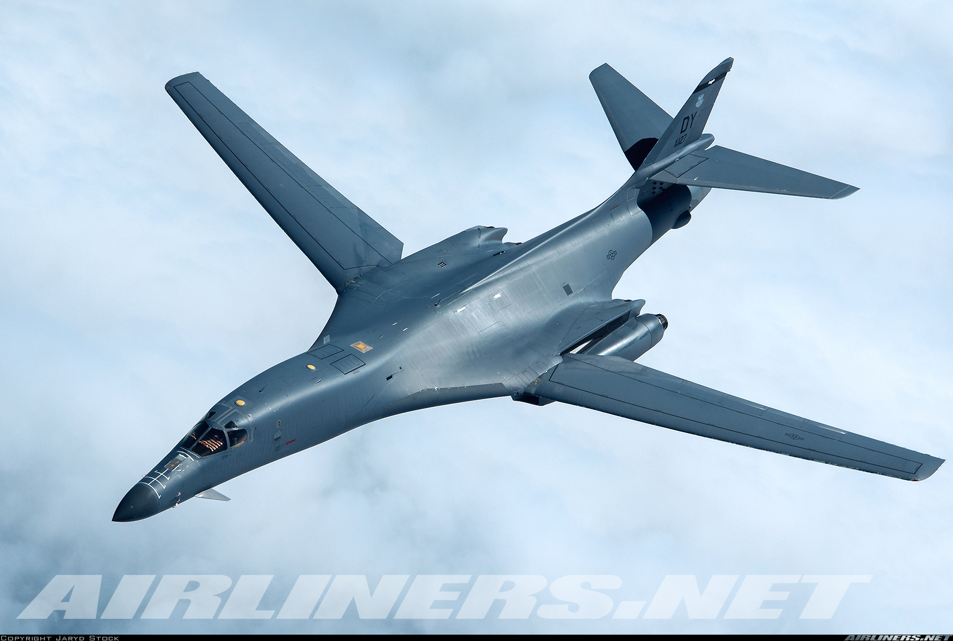
Wing Sizing & Design
Notes:
https://imgproc.airliners.net/photos/airliners/9/7/2/4909279.jpg?v=v44f4e5f8619
https://imgproc.airliners.net/photos/airliners/0/2/1/2156120.jpg?v=v40

Slide 20
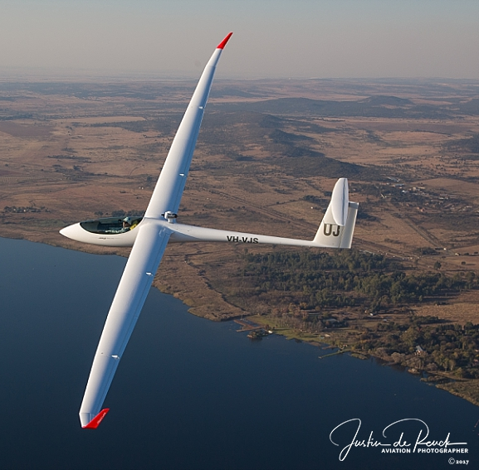
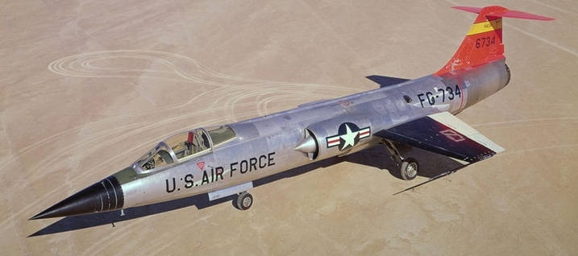
Wing Sizing & Design
Notes:
https://www.aviationphotographer.co.za/wp-content/uploads/2017/09/jsg_002.jpg
F104 Starfighter: https://www.armytimes.com/resizer/71QYTpeHZRlyFD_dnrqvaHtaOAk=/800x0/filters:quality(100)/arc-anglerfish-arc2-prod-mco.s3.amazonaws.com/public/4UVG2DNI6REB3N46F7HABKSA5U.jpg

Slide 21

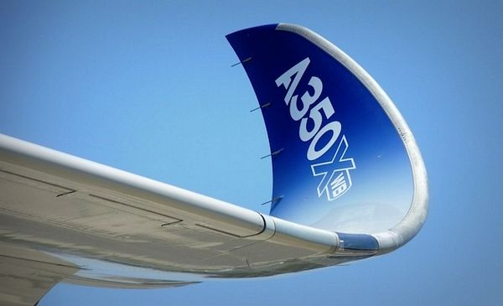
Wing Sizing & Design
Notes:
https://i.ytimg.com/vi/f-i3Tjk30Ps/maxresdefault.jpg
https://www.talkativeman.com/img/Sharklet_of_Airbus_A350_XWB.jpg

Slide 22
Lecture Contents
Wing Sizing
8.1. Introduction to Wing Design
8.2. Infinite Wings & Airfoils
8.2.1 Characterization and Performance
8.2.2 Selection Procedure
8.3. Finite Wings
8.3.1 Planform Parameters
8.3.2 Effect and selection of wing design parameters
8.3.3 Lift curve for finite wings
8.4. High Lift Devices
8.4.1 Trailing-Edge Devices
8.4.2 Leading-Edge Devices
8.5. Other Considerations
8.5.1 Wing Fuel Tanks
8.5.2 Integration of Wing Structures
8.6. Wing Design Checklist
Notes:
Contents from this slide deck is sourced and adapted from Aircraft Design 1 Course. Content by Dr. Joris Melkert from Delft, University of Technology

Slide 23
Lecture Contents
8.2 Infinite Wings & Airfoils
8.2.1. Airfoil Introduction & Definition
8.2.2. Characterization and Performance (Lift, moment and drag curves)
8.2.3. Effects of design parameters (camber, thickness, nose radius)
8.2.4. Effects of flow characteristics (viscosity and compressibility effects)
8.2.5. Selection Procedure
8.2.6. Airfoil Databases & Tools
Notes:
* Reading this section about airfoil (hence a 2D concept) you will see that is often necessary to anticipate concepts/parameters relative to the wing (hence a 3D concept), which will be discussed in the coming lectures. Make sure to read the complete series of wing design lectures at least twice before starting with the assignment, to get the clear complete picture!

Slide 24
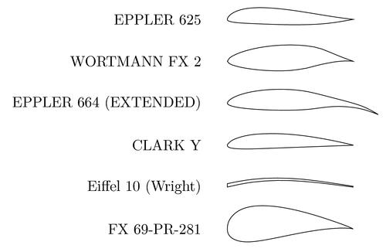
8.2.1 Airfoil Introduction & Definition
An Airfoil is a 2-dimensional cross section of a wing, blade or sail that produces an aerodynamic force when moving through a medium
The force component perpendicular to the flow is called Lift
The force component parallel to the flow is called drag

Slide 25
8.2.1 Airfoil Introduction & Definition
The classical airfoil shape is defined as a combination of a thickness distribution wrapped around the camber line:
+
=
Mean camber line
Symmetric thickness distribution
Airfoil Shape
Notes:
The shape of an airfoil (its curvature and thickness characteristics) can be considered as the sum of a curve (the camber line) with a symmetrical thickness distribution. The thickness distribution is actually wrapped around the camber line.

Slide 26
8.2.1 Airfoil Introduction & Definition
Airfoil thickness (measured normal to the chord, t/c)
Y
Upper curve, f(c)
Camber line
Lower curve, f(c)
Camber
(positive if above chord)
LE radius
X
Angle of attack
α
V∞
TE point
Freestream velocity
Chord (c)
LE point

Slide 27
8.2.1 Airfoil Introduction & Definition
The medium or mean camber line (or airfoil mean line) is the line equidistant (distance measured orthogonally to the camber line itself!) in every point from the upper and lower airfoil curves.
The chord is by definition the straight line going from the TE point (or half the TE thickness) to the farthest point on the airfoil, which is by definition the LE point on the airfoil. LE and TE point represent also the start and end point of the camber line.
The total airfoil camber is measured as the maximum distance between the camber line and the chord line, measured normally to the chord and typically expressed as percentage of the chord length.
The position of the maximum camber is also an important characteristic describing the airfoil. It is typically indicated as a percentage of the chord length.
The thickness of the airfoil is measured normally to the chord line.
The maximum thickness value as well as its position are important parameters affecting the behaviour of an airfoil.
The angle of attack α is measured as the angle between the direction of the freestream velocity (V∞) and the chord.

Slide 28
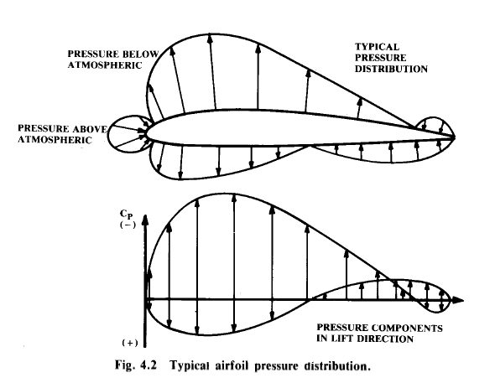
8.2.1 Airfoil Introduction & Definition
How airfoils work: the pressure field
An airfoils perturbs the freestream velocity
The flow is forced to deviate and accelerate along the airfoil
This acceleration generates pressure forces on the airfoil
The pressure distribution depends on:
The freestream conditions (AOA, viscosity, …)
The airfoil shape
This pressure fields can be used to calculate lift and drag:
Lifting force = The component of the pressure forces resultant normal to the freestream direction
Drag force = the component parallel to the freestream direction
Example of pressure distribution on an airfoil

Slide 29
8.2.1 Airfoil Introduction & Definition
The aerodynamic performance of airfoil sections can be studied by reference to the pressure distribution over the airfoil, expressed in terms of the pressure coefficient Cp:
Where:
Cp = difference between local static pressure (p) and freestream static pressure (p∞), normalized with the freestream dynamic pressure (1/2ρV²).
Note: C_{p} is normally plotted "upside-down" with negative values (suction), higher on the plot. This is done so that the upper surface of a conventional lifting airfoil corresponds to the upper curve.

Slide 30
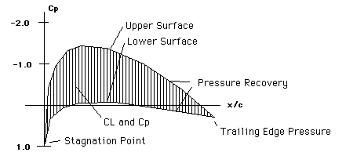
8.2.1 Airfoil Introduction & Definition
The area on the cp plot between the upper and lower surface profile is the Airfoil lift coefficient:
Upper Surface
Lower Surface
Pressure Recovery
x/c = position along chord (%) (LE = 0 and TE = 1)
Airfoil lift C_{l}
Stagnation Point
Trailing Edge Pressure
Notes:
The pressure distribution integrated around the airfoil is the airfoil lift force l.
This lift force normalized with the airfoil chord length and the dynamic pressure is the airfoil lift coefficient, indicate as C_{l}
l is used when referring to the airfoil (2D case)
L is used when referring to the wing (3D case); in this case the overall pressure distribution on the wing surface is normalised with the reference wing surface S.

Slide 31
8.2.1 Airfoil Introduction & Definition
The C_{p} value starts from about 1.0 at the LE stagnation point. It rises rapidly (i.e., the pressure decreases) on both the upper and lower surfaces and finally recovers to a small positive value of C_{p} near the trailing edge.
The change from negative to positive pressure gradient is the pressure recovery area:
Typically associated with transition from laminar to turbulent flow
Flow separation can occur if gradient is too severe
Shockwave formation can occur at high speeds
Pressure recovery area (region with adverse pressure gradient)
Upper Surface
Lower Surface
Pressure Recovery
Airfoil lift C_{l}
Stagnation Point
Trailing Edge Pressure
Notes:
The region of the pressure distribution where negative values start becoming less negative (pressure increases) is called the “pressure recovery region”. There the pressure increases from its minimum value to the value at the trailing edge. This area is also known as the region of adverse pressure gradient because the change from negative to positive pressure gradient is typically associated with the transition from laminar to turbulent flow and possibly with flow separation, in case the gradient is too severe.
Furthermore, according to the flow speed regime, the recompression might happen by means of a shockwave formation, which is cause of drag and flow instability (see more about this later).

Slide 32
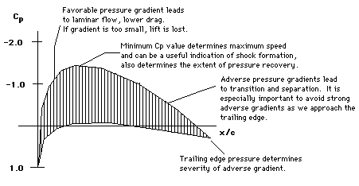
8.2.1 Airfoil Introduction & Definition
Favorable pressure gradients lead to laminar flow, lower drag. If gradient is too small, lift is lost.
Minimum Cp value determines maximum speed and can be useful indication of shock formation, and also determines the extend of pressure recovery (Mach Critical!)
Adverse pressure gradients lead to transition and separation. Avoid strong gradients near the trailing edge!
Trailing Edge Pressure determines severity of adverse gradient

Slide 33
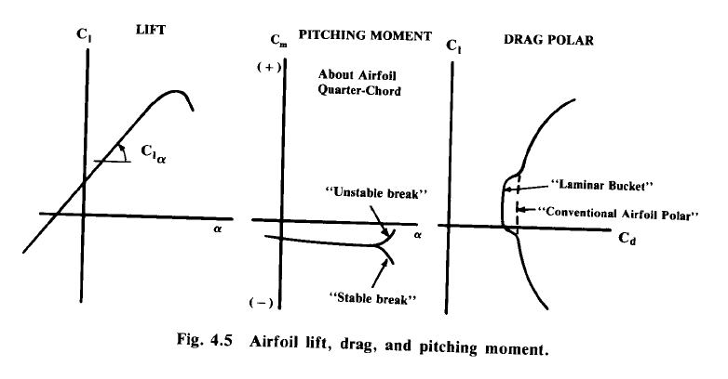
8.2.2 Characterization and Performance
From previous courses, the 3 non-dimensional coefficients C_{l}, C_{m} and C_{d}, and their variation w.r.t. AoA provides a total picture of the airfoil behaviour
C_{l}, C_{m} and C_{d} = f (α, Re, M)

Slide 34
8.2.2 Characterization and Performance
The performance of a given airfoil depends mainly on:
Angle of Attack (AOA, α)
Reynolds number (viscosity effect):
Typical values of Re (ρVx/μ) for General Aviation: 500000 - 6 million
Typical values of Re for airliners or fighters: 9 million +
Re depends on aircraft speed and flow characteristics , but also on the size x of the body immersed in the flow, The flow around a large aircraft is characterized by a larger Re value is different from a smaller aircraft, flying at the same conditions! For tapered wings generated by using only one airfoil, the behavior of the root section is different than the tip section behavior (see more of this when discussing about wing stall characteristics)
Mach number (compressibility effect).
C_{l}, C_{m} and C_{d} = f (α, Re, M)

Slide 35

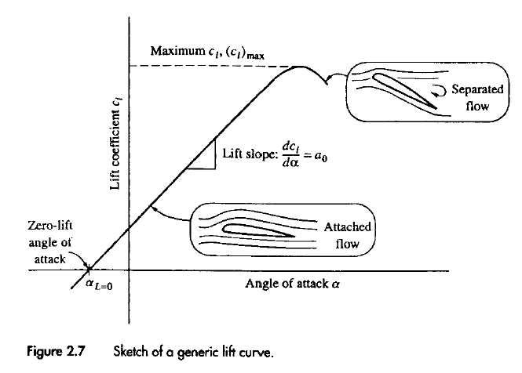
8.2.2 Characterization and Performance: C_{l}- α Curve (Lift Curve)
Linear airfoil theory states that the lift generated by the airfoil will increase linearly with the AoA, where 2π the gradient of the lift v.s. alpha curve Here, theoretical results are good for characterization (1)
In reality, the linear behaviour is lost starting from values of alpha close to the so called alpha stall (α_{s}), in correspondence of which C_{l} reaches its maximum value. Here, experimental data or complex computational models are needed for characterization (2)
For values of α larger than α_{s ,} lift decreases, while the drag increases due to flow separation
Stall area (2)
Linear area (1)
dC_{l}/dα = C_{lα} = 2 π [1/rad] = 0.11 [1/deg]
α
Note L in place of l * !
Notes:
POINT OF ATTENTION: 2π is the highest gradient according to the “theory for thin airfoils”. However, this is true only for low mach numbers (M <= 0.2), when no compressibility effects are present! See later about the effects of compressibility.
* As already mentioned, when discussing about the characteristics of an airfoil (i.e. 2D), we always use lower case for the l, d and m of lift, moment and drag coefficients!!!
The only case where we use upper case L is just and only for the AoA at zero lift (i.e. α_{0L}). Why? See later about finite length wing design.....

Slide 36
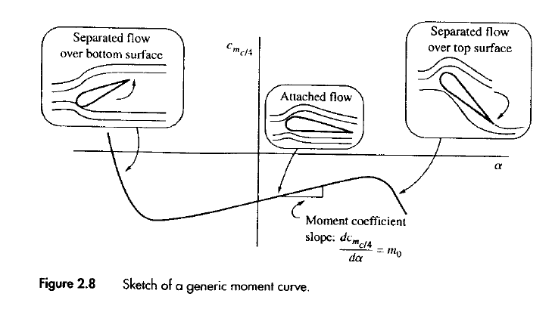
8.2.2 Characterization and Performance: C_{m}- α Curve (Moment Curve)
The pitching moment must be evaluated with respect to a reference point. C_{m} data typically found in literature are calculated around the quarter chord line (i.e., at 0.25c).
The moment coefficient of “conventional airfoil” is typically negative (hence pitch down), with the tendency of becoming less negative at increasing AoA. The aerodynamic moment acting on the airfoil is positive when it induces a pitch up rotation.
The stable or unstable behavior at stall depends on the specific kind of airfoil.
Unstable
Stable behaviour
α
dC_{m0.25C}/dα = C_{mα}
Stable
Unstable behaviour

Slide 37
8.2.2 Characterization and Performance: C_{d}- C_{l} Curve (Drag Polar)
C_{d}
The drag polar is used to identify the design lift coefficient: cruise conditions are set where drag is lowest at the bottom of the curve (or actually, the airfoil is designed such that the minimum drag occurs in cruise conditions)
This polar may also be rotated sideways (C_{l}- C_{d} Curve)
Near the polar minimum*, the drag contributions are due to friction. At higher AoA, the drag due to separation becomes increasingly important.
Some airfoils feature a “drag bucket”, depending on the design, Re number and surface roughness (see later about laminar airfoils like the NACA 6 family)**.
C_{dmin}
C_{lmax}
C_{l}
laminar bucket
C_{ldes}
Typical parabolic drag polar
Airfoil design lift coefficient
Drag polar with laminar bucket
Notes:
Is this airfoil cambered or uncambered? –Cambered since Cldes is not at cl=0
*where there is a linear relation between angle of attack and lift coefficient, of course it is possible to talk indifferently both in terms of C_{l} and α!
**The geometry of the airfoil is not the only factor. The Re value is important as well. There is a Re_Design value, beyond which the transition to a turbulent flow occours, with consequent enhancement of the airfoil friction drag. Also the actual roughness of the airfoil is determinant, hence both the manufacturing accuracy and the cleannes of the wing section (no insects and dirty) are determinant for the actual existance of the laminar bucket.

Slide 38
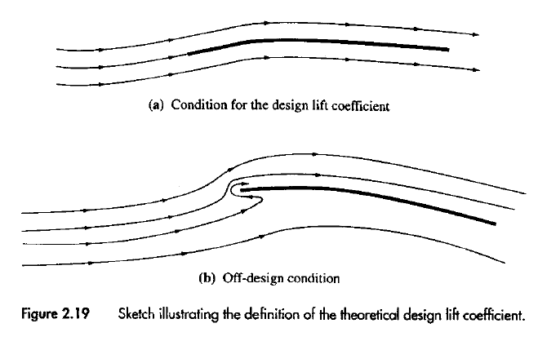
8.2.2 Characterization and Performance: Design Lift Coefficient
The design lift coefficient of an airfoil C_{ldes} is defined as the theoretical lift coefficient obtained at the angle of attack such that the slope of the airfoil camber line, at the leading edge, is parallel to the free stream velocity.
This is the optimal airfoil operative situation*, corresponding to least drag
C_{d}
b
a
Design Lift Coefficient Condition (a)
Off-Design Condition (b)
C_{l}
Notes:
* If we have to select an airfoil that has to operate most of the time at a certain C_{l} value (say C_{l} = XX), the smartest solution (those implying the least drag) is to use an airfoil whose C_{ldes} ≈ XX!
See more later, about selecting proper airfoil for a wing.

Slide 39
8.2.3 Effect of Design Parameters
Critical airfoil design parameters that affect airfoil performance:
Airfoil Camber
Airfoil Thickness
Airfoil Nose Radius*
Notes:
*The airfoil nose radius is a design parameter that affects the lifting capability of the wing in terms of max lift coefficient and stall angle. This will be discussed later with the estimation of the wing maximum lift coefficient.

Slide 40
8.2.3 Effect of Design Parameters: Airfoil Camber
Introducing camber results in higher values of C_{l} at of lower angles of attack
Increasing camber also increases the airfoils pitching moment
This affects the design of the aircraft tail: a wing with a high pitching moment will require “more work” from the tail to trim the aircraft (with the generation of trim drag).
The deployment of flaps has the same effect as increasing the camber of the wing (if there is no increase of the wing surface) and in flaps-down configuration the tail must succeed in balancing the strong increase in the wing pitching moment.
It’s not only the max camber that affects the airfoil behaviour, but also the position of the camber.
Bringing the camber forward increases C_{lmax} , but is not favourable for the stall characteristics.
Vice versa, rear positions of the camber lowers C_{lmax} but yield a more gradual stall transition.
Notes:
*On trainers and aerobatic aircraft low values of camber are typically used because of the inverted flight possibility.

Slide 41
8.2.3 Effect of Design Parameters: Airfoil Camber
C_{d}
α
Increasing Camber
Increasing Camber
C_{dmin}
C_{l}
Increasing Camber
C_{ldes}
α
Notes:
*The airfoil nose radius is a design parameter that affects the lifting capability of the wing in terms of max lift coefficient and stall angle. This will be discussed later with the estimation of the wing maximum lift coefficient.

Slide 42
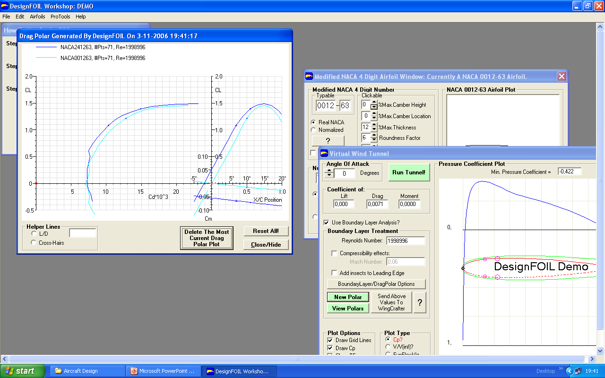
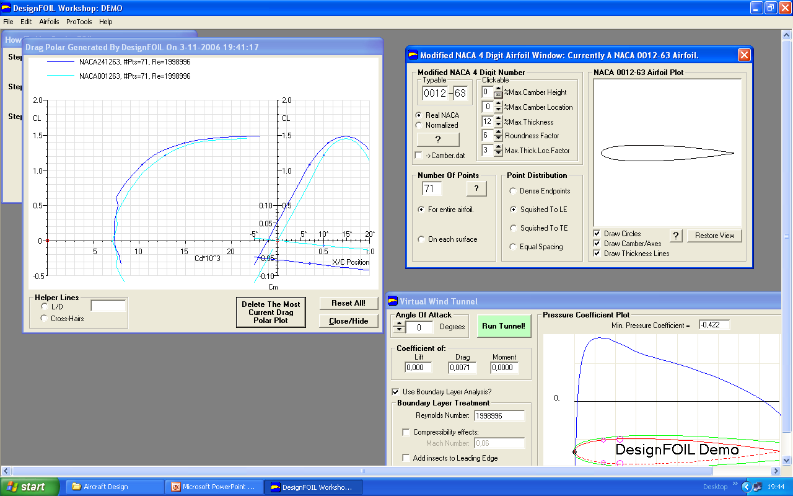
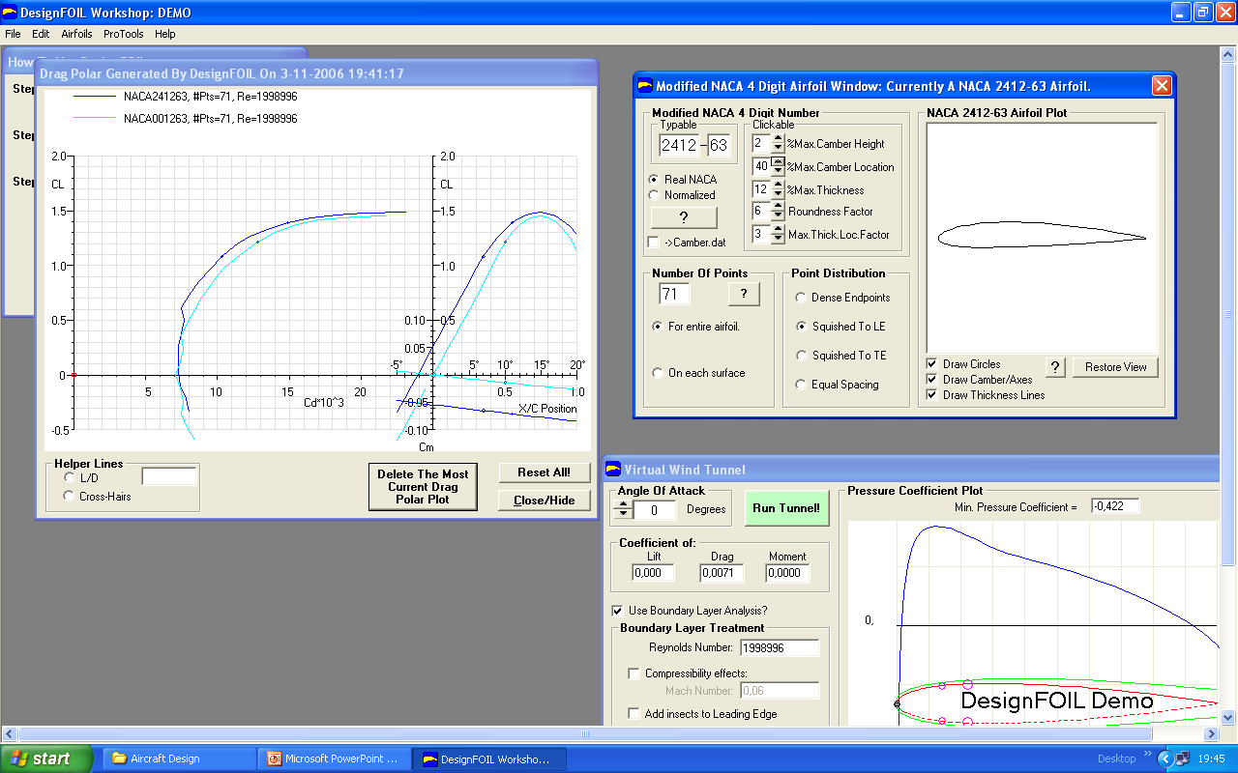
8.2.3 Effect of Design Parameters: Airfoil Camber
At zero AoA, the cambered airfoil is generating lift
C_{lα} is not affected
Increasing Camber
Increasing Camber
Increasing Camber

Slide 43
8.2.3 Effect of Design Parameters: Airfoil Thickness
The maximum thickness (t/c) of the airfoil and its position along the chord (x/c)_{t/cmax} have direct influence on:
Maximum lift (c_{lmax})
Airfoil stall characteristics*
Drag (c_{d}) (also discussed later together with the compressibility effect. I.E. (T/c) effect on M_{crit})
Wing volume & structural weight (discussed later relatively to the wing characteristics)**
Notes:
* The stall characteristics of the airfoil (2D) of course influence the stall characteristics of the whole wing (3D) built up with that airfoil. However, a wing is generally built of different kinds of airfoils, and, in case of twist and taper, each single airfoil on the wing works at different condition (different angle of attack, different Re). Also, in case of swept wing and anyhow close to the wing root and tip areas, there are strong 3D effects, which modify the way the airfoil works nominally in 2D. So the airfoil stall characteristics are not inherited right away by the wing! it’s not generally true that a wing built of medium thickness airfoils has bad stall characteristics (as discussed next slides).
** this is not really about airfoil behaviour, but wing performance, though there is a direct effect!

Slide 44
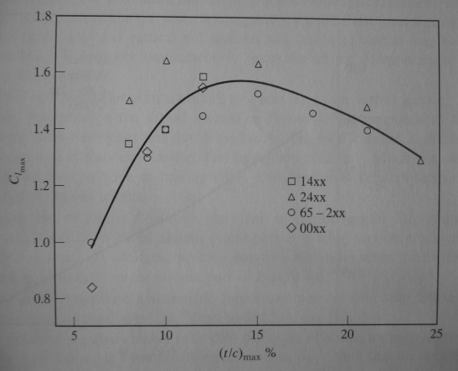
8.2.3 Effect of Design Parameters: Airfoil Thickness Effect on C_{lmax}
Aerodynamically, there is no reason to use airfoils thicker than 14%.
Thicker airfoils will increase the suction peak and lower the M_{crit} which is negative for high speed wings and might require the use of a sweep angle.
From a structure point of view, the use of thick airfoils is beneficial to lower the wing bending stresses (hence lower the wing weight) and/or to increase the wing volume for fuel and/or landing gears storage
(t/c)_{max}% = 14
Notes:
Source Corke

Slide 45
8.2.3 Effect of Design Parameters: Airfoil Thickness Location Effect
The location of the airfoil max thickness has a large influence on the airfoil behavior and is very related to the location of the airfoil maximum pressure position.
Hence the further back it is positioned:
The lower the minimum drag,
The higher the Mach critical (lower maximum pressure peak)
But the further back it is positioned …
The lower C_{lmax}
The higher the drag increase
The most common max. thickness location is around the 30-40% of the chord, and rarely higher
Notes:
Source Corke

Slide 46
8.2.3 Effect of Design Parameters: Airfoil Thickness Location Effect
Shifting to rear
C_{d}
Shifting to rear
Shifting to rear
α
C_{dmin}
C_{l}
C_{ldes}
α
Minimal Effect

Slide 47
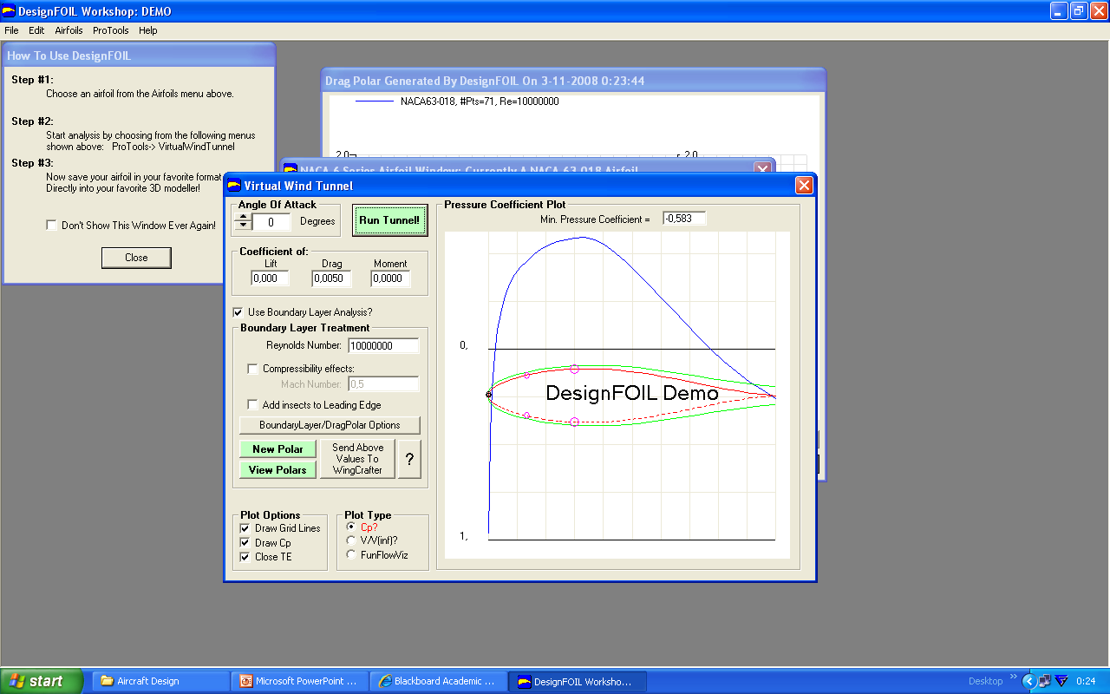
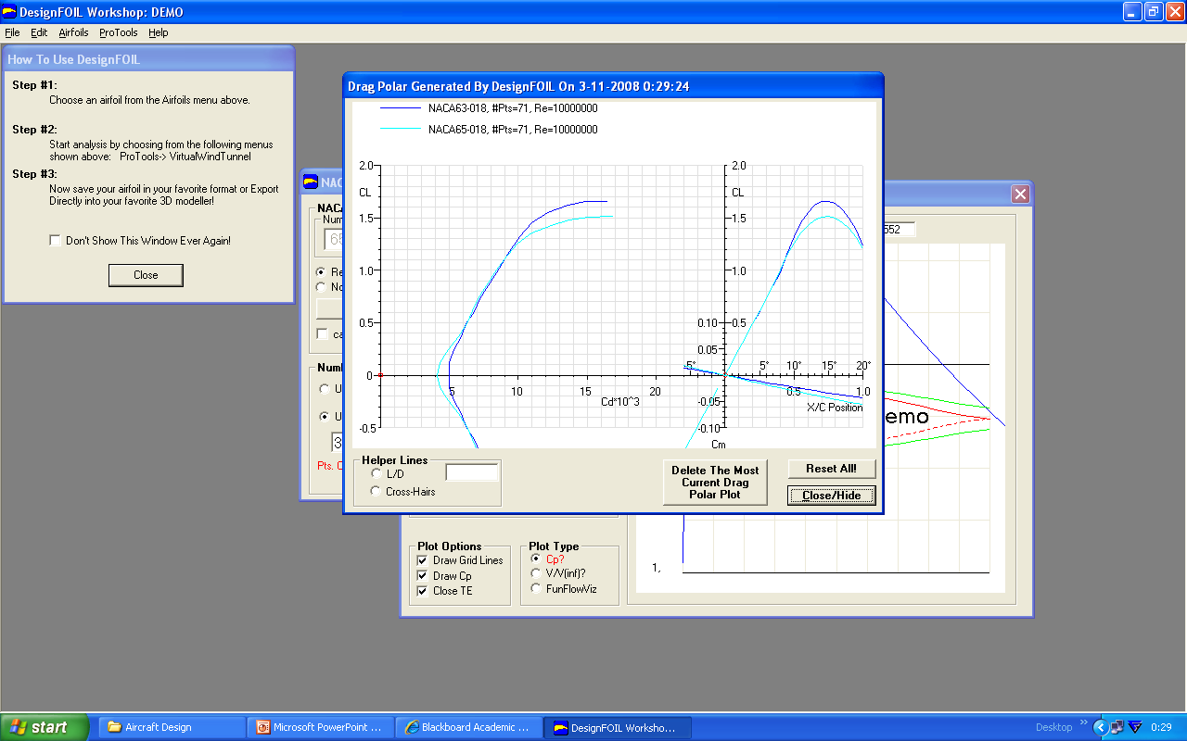
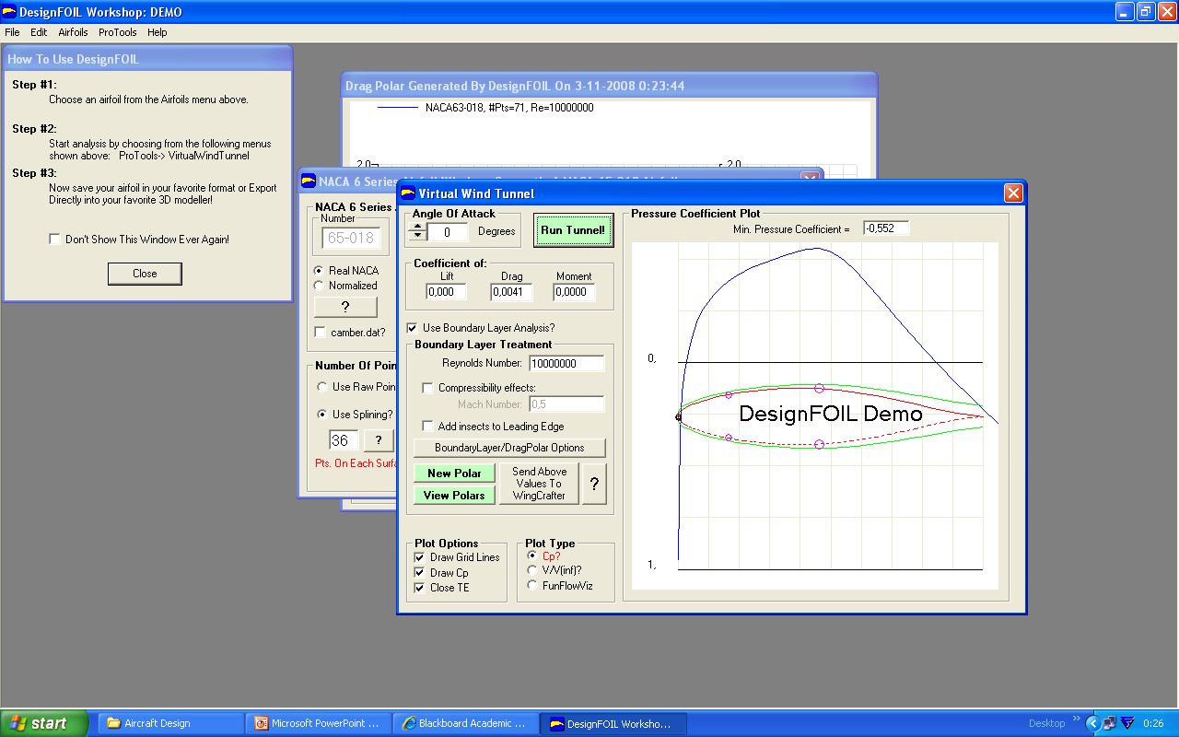
8.2.3 Effect of Design Parameters: Airfoil Thickness Location Effect (NACA 63/65-018)
Shifting to rear
Shifting to rear
Shifting to rear
Shifting to rear
Minimal Effect

Slide 48
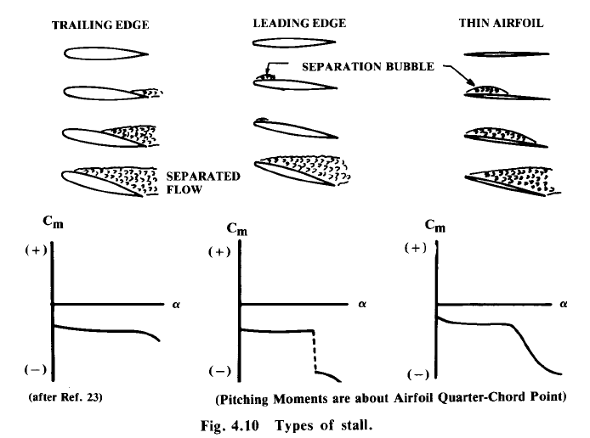
8.2.3 Effect of Design Parameters: Airfoil Thickness Effect on Stall
The thickness of the airfoil (and size of the LE radius) strongly determine how stall is reached, as well as the post stall condition
Thin Airfoil
(t/c)_{max} < 6%
Medium Thickness
6% ≤ (t/c)_{max} < 14%
Thick Airfoil
(t/c)_{max} ≥ 14%
Notes:
Source Raymer
1) Thin airfoils feature the generation of separation bubble near the LE, similarly to the medium thick airfoils. The difference is that in this case the bubble extends gradually towards the TE, when alpha increases. At that point the flow results completely separated. Large changes in the lift and pitching moment are then experienced, though the variations are gradual and not abrupt.
2) Moderate thickness airfoils (6%<t/c<14%) show flow separation at the nose already at very low angle of attack. The flow anyway reattaches very soon creating a kind of bubble. This separation bubble remains constant for quite some increments of alpha, until it suddenly bursts creating total and abrupt separation of the flow, hence a discontinuity in the lift and pitching moment. Of course a wing (3D) showing such stall behaviour would not be ideal. However the stall behaviour of a wing is generally different than that of the implemented airfoils (see note previous slide). Indeed the greatest majority of aircraft has the wing thickness included in this range!
3) Thick airfoils (>14%) stall from the TE edge. The boundary layer thickness increases with alpha. Around 10 degree it begins to separate. The separation zone grows gradually with increasing angle of attack. The stall is gradual and the variation in the pitching moment are very small.

Slide 49
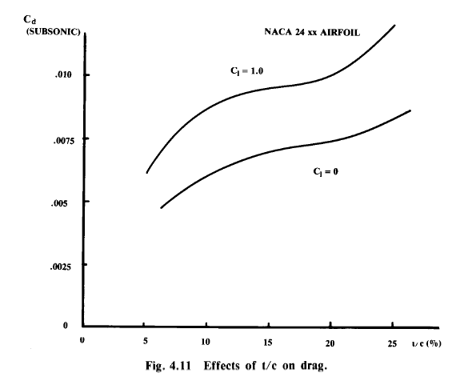
8.2.3 Effect of Design Parameters: Airfoil Thickness Effect on Subsonic Drag
Given two airfoils with same chord:
The thicker airfoil will feature higher friction drag, because the flow will “touch” the airfoil over a longer perimeter.
The associated form drag is also higher because of the earlier separation of the flow.
Intuitively a thicker airfoil will perturb the flow more than a thinner one. Every perturbation will correspond to an amount of energy dissipated in the flow, hence drag!
C_{d} (subsonic)
Increasing Thickness
(t/c)%

Slide 50

8.2.4 Effects of Flow Characteristics
As mentioned before C_{l}, C_{d} and C_{d} = f (α, Re, M)
The viscosity effect can be investigated based on Reynolds Number:
Compressibility effect can be investigated based on Mach number:
For Assignment 3:
The chord length c affects Reynolds number, and is currently unknown. Assumptions will have to be made using the Mean Aerodynamic Chord (next lecture)
The speed V is the freestream velocity component in the plane of the airfoil. An assumption will need to be made for sweep angle
Iterations may be required, see note!
Notes:
*Re is function of x, which is a geometric reference length for our airfoil, typically the chord length. Note that you will have to calculate Re, when the chord length of the airfoil to be studied is eventually not known yet! An assumptions will have to be made on the value, e.g., of the wing mean aerodynamic chord (MAC – see next lecture) and iterations might be required!
The speed V is also the freestream speed component in the plane of the airfoil! On swept wings this component is not the same as the freestream speed V∞. Again, an assumption will have to be made on the sweep angle in order to evaluate a proper value of Re. Iterations might be required in case that assumption will appear to be too far off.

Slide 51
8.2.4 Effects of Flow Characteristics: Viscosity Effects
The Reynolds Number has a great effect on C_{lmax} (which also depends on t/c and camber)
It is important that the right Cl-alpha curves are used when analysing low speed wing performance
High Re values allow the flow to stay attached longer (the boundary layer has more energy to cope with the adverse pressure gradient), hence decreasing the drag contribution due to flow separation and increasing the maximum value of lift coefficient!
At low speed (Take off and landing), it is important the wing is able to provide the highest C_{Lmax}. Since the wing C_{Lmax} depends on the C_{lmax} of the airfoils, it is important that the appropriate low-speed Re is used to calculate C_{lmax}.
Using the Cl-alpha curves for cruise condition would bring to a large overestimation of the actual maximum lifting capability of the wing at low speed!

Slide 52
8.2.4 Effects of Flow Characteristics: Viscosity Effects
C_{d}
Increasing Re
Increasing Re
Increasing Re
α
C_{dmin}
C_{l}
C_{ldes}
α
Minimal Effect

Slide 53
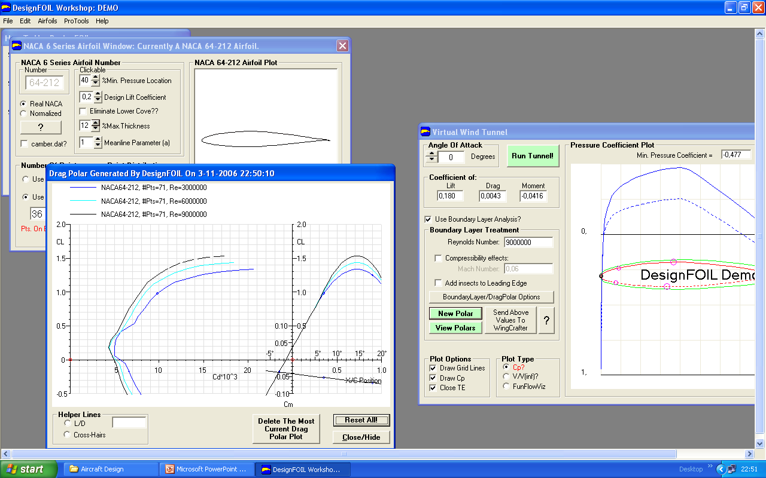
8.2.4 Effects of Flow Characteristics: Viscosity Effects (Re = 3M, 6M, 9M)
Significant effect
Friction and form drag decrease with higher Re
Increasing Re
Increasing Re
Increasing Re
No Effect
No Effect
Notes:
The drag polars show the effect of Re in decreasing the skin-friction coefficient C_{f}. Attention! higher Re numbers yield lower friction coefficient values until the flow is laminar. As soon as there is the transition to turbulent, the friction increases suddenly and then begins decreasing again with increasing Re. Infact C_{f} = 1/Re^0.5 (laminar flow) and C_{f} = 1/Re^0.2 (turbulent flow)

Slide 54
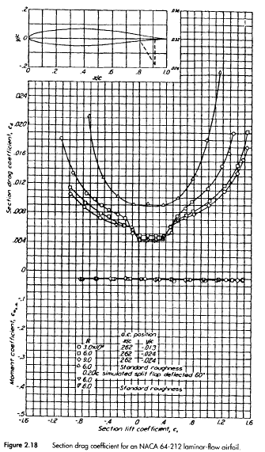
8.2.4 Effects of Flow Characteristics: Compressibility Effects: Mach Effect
All the experimental curves, like the figure from Abbott*, do not show any effect of the Mach number on the airfoil performance.
That’s because they were drawn with data collected in a low speed subsonic wind tunnel. No compressibility effect could be reproduced at the available speed (M< 0.2).
The aerodynamic coefficients of an airfoil change as the Mach number of the freestream flow increases!
Notes:
* See later for the complete reference

Slide 55
8.2.1 RECAP: Airfoil Introduction & Definition
The aerodynamic performance of airfoil sections can be studied by reference to the pressure distribution over the airfoil, expressed in terms of the pressure coefficient Cp:
Where:
Cp = difference between local static pressure (p) and freestream static pressure (p∞), normalized with the freestream dynamic pressure (1/2ρV²).
Note: C_{p} is normally plotted "upside-down" with negative values (suction), higher on the plot. This is done so that the upper surface of a conventional lifting airfoil corresponds to the upper curve.

Slide 56
8.2.4 Effects of Flow Characteristics: Compressibility Effects: Mach Effect
C_{l} grows with M (up to M=1)
The Prandtl-Glauert compressibility corrections can be used for a reasonable estimation of C_{l}.
The same corrections can be used also for the airfoil moment coefficient.
Similarly, we can use these corrections also for C_{L} and C_{M} of the 3D wing
Notes:
More complex analytical relations can be found in literature that are able to approximate the real Cl-M curve better than the P-G compressibility correction factor. However, the P-G method is one of the most simple, yet very good for the scope of conceptual design.
Note that Clα, the lift curve slope of thin airfoils, is equal to 2π only for low mach numbers, when there are no compressibility effects. As soon as mach increases also Clα increases to higher values than 2π [1/rad]!

Slide 57
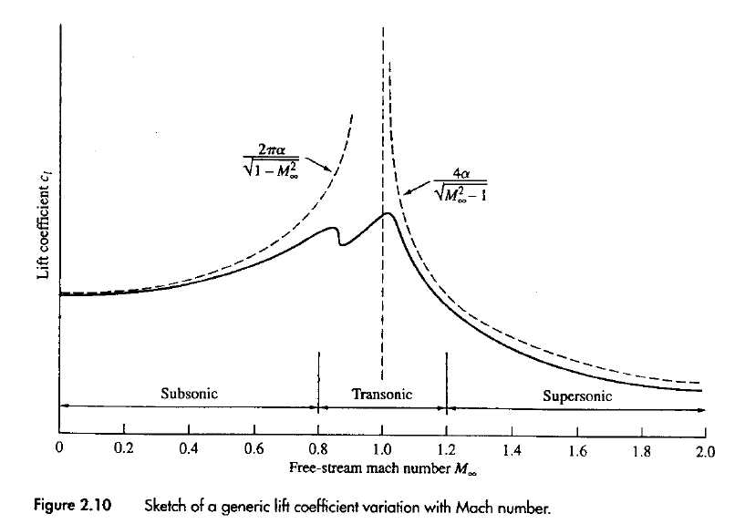
8.2.4 Effects of Flow Characteristics: Compressibility Effects: Mach Effect
C_{l}
The oscillatory behaviour of the curve in the transonic regime are due to the interaction between shock waves and boundary layer.
analytical curve
C_{l}=2πα
Compressibility effects neglectable
Experimental curve
M∞
Notes:
Source Anderson
Note that Clα, the lift curve slope of thin airfoils, is equal to 2π only for low mach numbers, when there are no compressibility effects. As soon as mach increases also Clα increases to higher values than 2π [1/rad]!

Slide 58
8.2.4 Effects of Flow Characteristics: Compressibility Effects: Mach Effect
The behaviour of C_{d} at growing Mach is different than C_{l}
C_{d} remains constant until a critical Mach number M_{critical} (smaller than M = 1!)
At M_{critical} , the sonic conditions are reached locally on one point of the airfoil
Before M_{critical} , the drag is mainly due to friction. Compressibility does not have a relevant effect on friction drag. After M_{critical} , wave drag becomes dominant
After M_{critical} , a pocket of supersonic flow starts growing on the airfoil (sometimes also on the lower part of the airfoil). A shock wave is formed at the end of this pocket (after that the flow returns subsonic).
As the shock wave grows, the large adverse pressure gradient associated to the flow recompression creates a growing separation of the flow, which causes steep drag increase!
Notes:
Airflow speeds up over the top of an airfoil

Slide 59
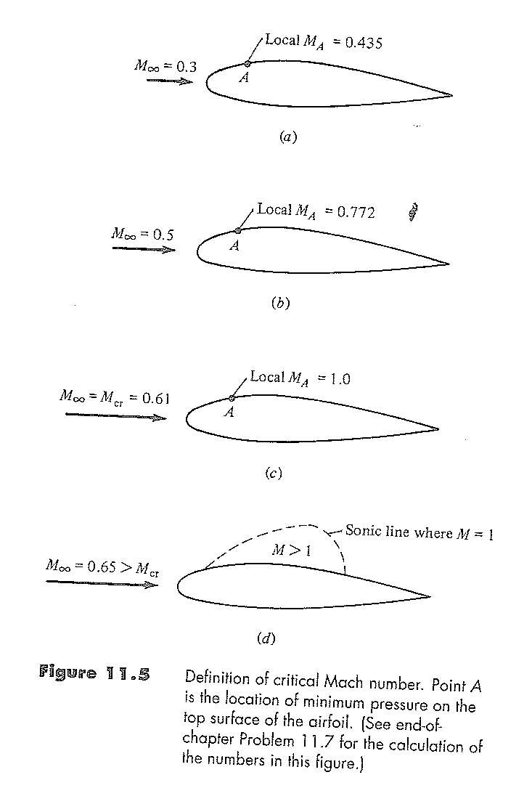
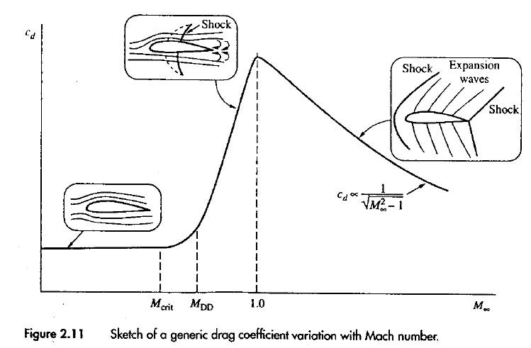
8.2.4 Effects of Flow Characteristics: Compressibility Effects: Mach Effect
The behaviour of C_{d} at growing Mach is different than C_{l}
C_{d}
The critical Mach number (M_{cr}) is a specific value of the freestream Mach number (<1) in correspondence of which, the sonic condition (M=1) are locally reached on one airfoil point.
M∞
Notes:
Source: Anderson
Mach crit
Mach drag divergence

Slide 60
8.2.4 Effects of Flow Characteristics: Compressibility Effects: Mach Effect
M_{critical} can be regarded as a warning value!
Often addressed in literature as M_{cr}
Also addressed as M_{CC}, i.e. Mach crest critical, because the critical conditions are reached in correspondence of the peak or crest of the pressure distribution on the airfoil)
The actual drastic drag increase is encountered at Mach values slightly higher than M_{cr} , i.e. in correspondence of the so called M_{DD} (Mach drag divergence), or simply M_{div}.
For conventional airfoils M_{div} is 2-4% higher than M_{cr}. As discussed later, special airfoils, so called supercritical, can push M_{DD} further to values about 6% higher than M_{cr} !

Slide 61
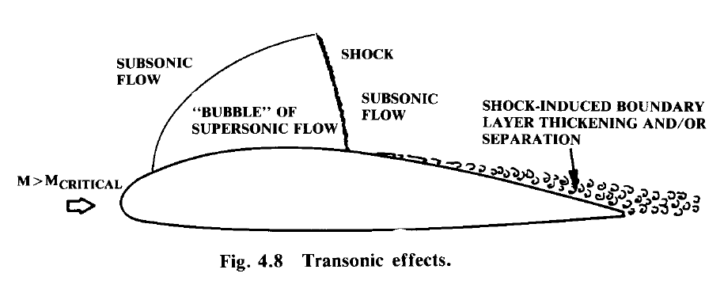
8.2.4 Effects of Flow Characteristics: Compressibility Effects: Airfoil Critical Mach Number
After the sonic conditions are reached on the airfoil, a further increase in the freestream velocity causes the generation of shock wave(s). The recompression after the shock wave induces boundary layer thickening and then major flow separation.
To keep the drag low, it is important to select airfoils with higher critical mach number than the maximum design Mach number*!
M_{des} < M_{Div}
M_{des} < M_{cr}
Notes:
* When the strength of the shock wave is such that starts causing flow separation, it means that M_{DD} (mach drag raise/drag divergence) has been reached.
It is important that M_{DD} is never reached during operations. It is here and not in correspondence of Mcr, that the big increase in drag happens.
As mentioned in the previous slide, Mcr can be considered as a sort of “warning value”.

Slide 62
8.2.4 Effects of Flow Characteristics: Compressibility Effects: Airfoil Critical Mach Number
Since different airfoils accelerate the flow around their boundary differently, we can immediately see that different airfoils have different values of M_{cr}
Intuitively: thicker airfoils force the flow to accelerate to higher speeds compared to thin airfoils (of the same kind)
Conventional thick airfoils reach critical conditions at lower values of the freestream Mach than thin airfoils
The airfoil thickness plays a fundamental role in determining the critical Mach number (but not only thickness!*)
Notes:
*The shape of the airfoil determines the shape of the pressure distribution, hence the amount of the minimum pressure value, i.e. the maximum speed value!
An airfoil that is able to generate the same amount of lift than another, but with a lower maximum pressure peak, will encounter the sonic critical conditions obviously later (C_{pmin}!).

Slide 63
8.2.4 Effects of Flow Characteristics: Compressibility Effects: Airfoil Critical Mach Number
The question now is:
How to make sure we are using airfoils with adequate M_{cr} for our mission?
Three possibilities are illustrated in the following slides (in order of increasing effectiveness)
Look at statistics, historical trends and reference aircraft (good to get a rough feeling)
Use experimental data (when available!) showing the variation of M_{cr} with the maximum airfoil thickness*
Calculate the actual M_{cr} of the given airfoil!
Notes:
* See previous note: Critical mach is not only function of the airfoil thickness, but of its shape in general which determine the intensity of the suction pick (C_{pmin})

Slide 64
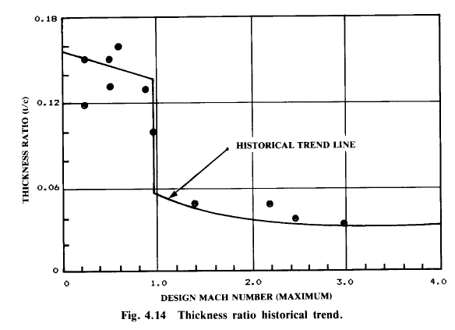

8.2.4 Effects of Flow Characteristics: Compressibility Effects: Airfoil Critical Mach Number
1 - Historical trend of (t/c)_{max} on the main wing of aircraft vs. design Mach number:
t/c=0.15
M=0.8
Notes:
Source: Raymer
Attention: in this picture it is not shown any information concerning wing sweep angle values required to use such thickness values! E.g.,a t/c value of 0.15 is normal for Mach values around 0.8, however NOT for unswept wing!!! Need to correct for sweep in the aircraft
The same data are plotted in fig 4.5. of Corke, nevertheless a different trend curve has been built, which does not show (like in the picture above) the discontinuity in the (t/c) values which do not really go below 12% for design MACH<1, while they are always below 6% for supersonic cruise speed.

Slide 65
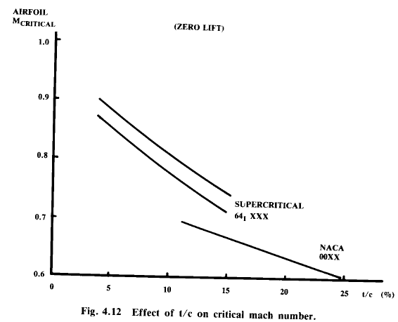
8.2.4 Effects of Flow Characteristics: Compressibility Effects: Airfoil Critical Mach Number
2 - Historical trend of (t/c)_{max} on the main wing of aircraft vs. crit. Mach number:
Curves from experimental data (zero lift)
Airfoil M_{cr}
Supercritical
10%
NACA 64₁ XXX
NACA 00XX
(t/c)%
Notes:
Source: Raymer
Note how, for the same value of Mcr, supercritical airfoils can be 10% thicker than conventional airfoils (conventional airfoil thickness ratio times 1.1) which is advantageous in term of weight and space for fuel, landing gear, systems etc. We can also read the graph like this: supercritical airfoils have a higher Mach critical values than other NACA 4, 5, 6 families of the same maximum thickness!
Note also how series 6 airfoils, of the same thickness as NACA series 4 and 5 airfoils, have a far higher Mcr.

Slide 66
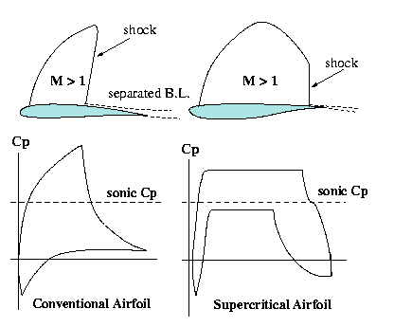
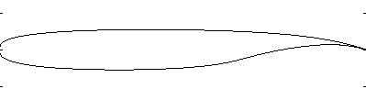
8.2.4 Effects of Flow Characteristics: Compressibility Effects: Airfoil Critical Mach Number
Intermezzo: Supercritical Airfoils
Supercritical airfoils are designed to delay the transonic drag rise (M_{DD})
Compared to a conventional airfoil, a supercritical airfoil has a smaller camber, a larger leading-edge radius, a small surface curvature on the suction side and a concavity in the rear part of the pressure side.
Flat suction
Large LE Radius
Concavity
Small camber
Whitcomb supercritical airfoil
Notes:
The shape of a SC airfoil is such that, on the suction side, the steep supersonic acceleration of the conventional airfoil is eliminated. The flow reaches supercritical speed, that is maintained over a large part of the airfoil. Then there is a small pressure plateau behind the shock and a pressure recovery in the trailing edge region. The reduction in local Mach number reduces the strength of the shock when the flow decelerates below critical speed. Aft loading and relatively high pitching moment values are other characteristics of supercritical airfoils. This has strong influence on the design of the tail, which has to counterbalance a stronger wing pitching moment than in case conventional airfoils are used, hence increasing the trim drag contribution.
The first supercritical airfoils were designed and analyzed by Whitcomb at NASA Langley in the 1950s flown first on F8 1971.
Source http://aerodyn.org/HighSpeed/supercritical.html
You can download the NASA official report at http://ntrs.nasa.gov/archive/nasa/casi.ntrs.nasa.gov/19900007394_1990007394.pdf)

Slide 67
8.2.4 Effects of Flow Characteristics: Compressibility Effects: Airfoil Critical Mach Number
3 - Calculating the critical Mach number for any airfoil:
M_{inf}=M_{cr,}
_{Ma=1}
Example:
This equation is just the relation for isentropic flow, It has no connection with any specific airfoil shape!
Notes:
Equation to calculate the pressure coefficient along a streamline
* Gamma is equal to Cp/Cv, where Cp (do not confuse this with the pressure coefficient!) and Cv are the specific heat at constant pressure and the specific heat at constant volume of gas, respectively. Gamma=1.4

Slide 68
8.2.4 Effects of Flow Characteristics: Compressibility Effects: Airfoil Critical Mach Number
3 - Calculating the critical Mach number for any airfoil:
When we know how the value of the minimum pressure coefficient on a given airfoil varies with Mach, we can find the value of M_{cr} for that given airfoil.
When we have C_{p,0,} which is the low speed (incompressible) value of the pressure coefficient at the minimum pressure point on the given airfoil (the crest of the pressure distribution), by using the Prandtl compressibility correction, we can draw the curve of the C_{p} with M∞.
C_{p}
M∞
You can calculate this value using a panel code*
Notes:
*DesignFoil can compute the pressure distribution of a given airfoil and automatically shows the value of the minimum value for the pressure coefficient (on the crest of the pressure distribution)
Be careful of computing the pressure distribution without switching on the compressibility effect option on DesignFoil! Just account for the compressibility effects by yourself using the P-G correction factor!
On the other side Javafoil computes directly the Mcr values for a given airfoil (for given angles of attack)

Slide 69
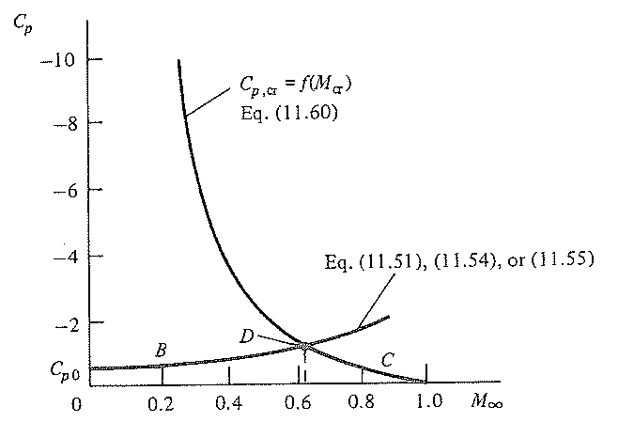
8.2.4 Effects of Flow Characteristics: Compressibility Effects: Airfoil Critical Mach Number
3 - Calculating the critical Mach number for any airfoil:
The intersection of these two curves will give the value of the M_{cr} specific for the airfoil.
Airfoil independent curve:
M_{cr}
Airfoil dependent curve:

Slide 70
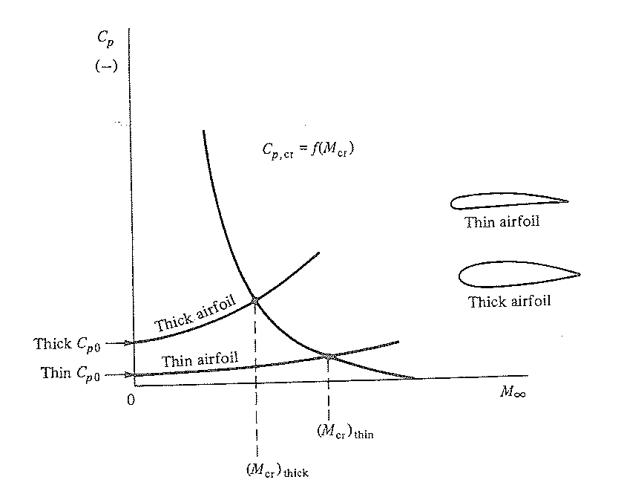
8.2.4 Effects of Flow Characteristics: Compressibility Effects: Airfoil Critical Mach Number
3 - Calculating the critical Mach number for any airfoil:
Thick airfoils have in general a more negative C_{p0} than similar thin airfoils, hence their C_{p} curve will intersect the C_{p,cr} curve at lower values of M_{cr.}
Notes:
Reference Anderson Fundamental of aerodynamics (pag 604-611)

Slide 71
8.2.4 Effects of Flow Characteristics: Compressibility Effects: Airfoil Critical Mach Number
3 - Calculating the critical Mach number for any airfoil:
What to do if M_{des} > M_{cr}:
Chose a similar but thinner airfoil, or
Chose a different airfoil with a less negative C_{p,0} , or
Make sure the given airfoil operates at lower Mach. I.e. select a sufficient wing sweep angle (Λ) such that
BAD!
GOOD!
M_{dive}cosΛ ≤ M_{DD}
M_{des}
This third approach is the main reason why swept wings are used!!
Notes:
In order to avoid problem of big shock waves formation with consequent flow separation, we have to make sure that Mach drag divergence (MDD) conditions are reached on the airfoil at safely higher Mach values than the freestream Mach during dive (i.e., at the maximum operative speed of the aircraft!).
The use of Mcr and cruise speed to perform the check might result in too conservative results (better too conservative than the opposite.…)
Use the first method graph in slide 57 to find thickness to chord, find an airfoil use javafoil to find the Cp, then check with the 3rd what the critical mach number. Make the graph and check if you’re on the good or bad side.

Slide 72
8.2.5 Selection Procedure
At this point, we know everything we need to know about airfoils to design the aircraft
The question now is:
How to select the appropriate airfoils for our specific wing design case?
Notes:
We know a lot about our airfoil design, but we don’t know a few things too. Like the geometry.
To design our wings, we need to look at how much lift we need

Slide 73

8.2.5 Selection Procedure
The cruise condition (or the flight condition at which the aircraft is supposed to fly most of the time*) must be considered. The total aircraft generated lift (L_{tot}) must equal the aircraft weight:
L_{tot} = W_{cruise}
How much lift (L) has to be generated by the wing? For a conventional aircraft configuration, the following approximation holds:
L≈1.1 L_{tot}
The extra 10% is to compensate for the negative lift contribution generated by the tail to trim the aircraft.
In case of canard aircraft or tandem aircraft, where more lifting surfaces contribute to the generation of L_{tot}, each “wing” will have to be designed based on its required lift contribution!
Notes:
Normally optimize for cruise condition, but optimize for whatever condition you expect to spend the most time or fuel in.
*In case of reconnaisance aircraft or any other aircraft type which must spend most of its mission during loiter, it is advisable to optimize the wing design for that phase of the mission (hence consider the right aircraft weight, e.g. it’s loiter weight)
*In case of mission requiring multiple cruise phases (e.g. with a combat in between, or a release of payload) it is advisable to optimise the wing design for the first cruise stage or before payload release.

Slide 74
8.2.5 Selection Procedure
The required wing lift coefficient can be calculated as follows:
Since the weight of the aircraft changes during the mission (due to fuel consumption), assuming a constant value of q during cruise *, the aircraft must be trimmed at different values of C_{L}.
The average C_{L} is what we will call the wing design lift coefficient C_{Ldes}
With
Notes:
W/S is part of the equation but changes over the duration of our flight
*In order to keep the wing flying trimmed at the optimal value of C_{L} (since large excursions of C_{L} can lead to quite higher value of drag), q can be changed. So, either the speed is lowered, which is not economically convenient, or the flight altitude is progressively increased (to lower the density value). The latter approach explains the typical climb steps cruise used by airliner to maximize the range! For the scope of our conceptual design is good enough to consider q fixed and look at CL variations.
W/S

Slide 75
8.2.5 Selection Procedure
The design wing lift coefficient can then be calculated as follows:
It is also interesting to compute the excursion of C_{Ldes} (i.e., how it varies during the most fuel intensive part of the mission*)
What kind of airfoils should we use to build up a wing with such lift coefficient?
Note that you have already computed these two values in assignment 2*!
Notes:
As discussed in the previous slide, the cruise is typically the most fuel intensive part of the mission, with exception of long endurance mission.
In case of combat aircraft or military trainers, the most fuel intensive part of the mission is the combat or combat simulation. However, during that phase the aircraft typically flies at very NOT constant CL, hence it does not make sense to optimise the wing design for a not existing C_{Lcombat}!

Slide 76
8.2.5 Selection Procedure
What kind of airfoils should we use to build up a wing with such lift coefficient?
Airfoils that allow the wing to fly at C_{Ldes} in conditions of minimum drag!
Notes:
From assignment 2 you will have W/S, climb speed, maneuverability, landing, take-off, climb angle.
Correct your W/S with the fuel burned, broquet equations

Slide 77
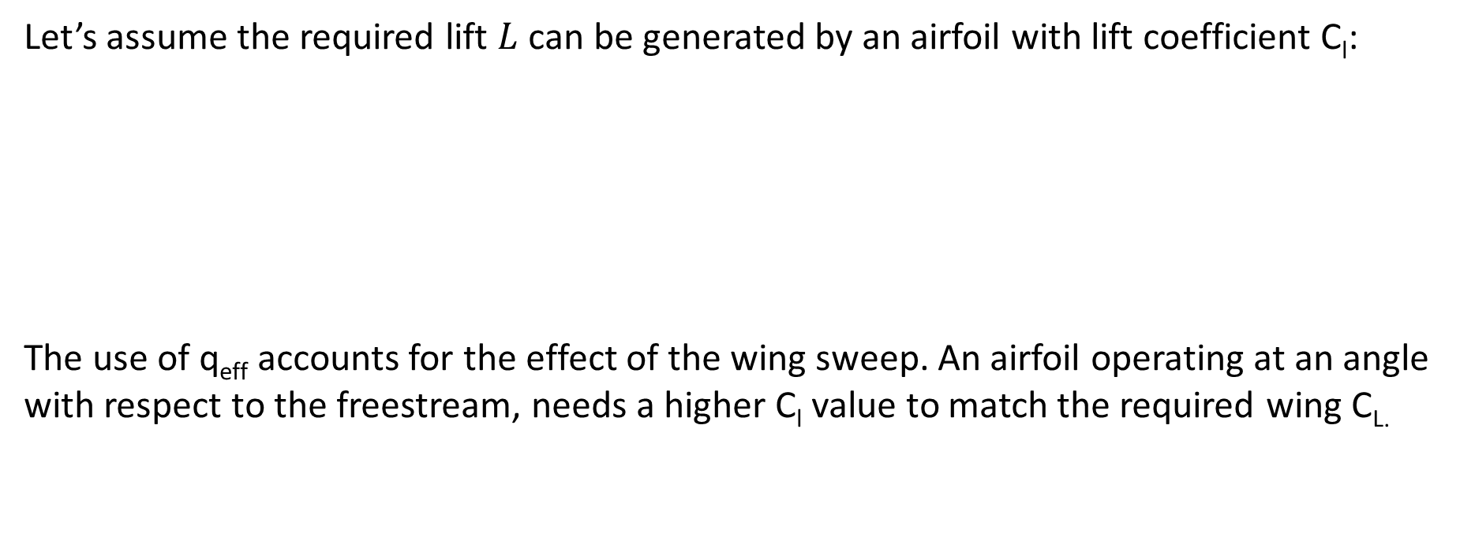
8.2.5 Selection Procedure
Let’s assume the required lift $L$ can be generated by an airfoil with lift coefficient C_{l}:
The use of q_{eff} accounts for the effect of the wing sweep. An airfoil operating at an angle with respect to the freestream, needs a higher C_{l} value to match the required wing C_{L.}
Where
With
Resulting in:
Notes:
The approximation that the required lift can be generated by a lift coefficient Cl is important!
The higher the sweep angle is, the higher the lift coefficients Cl of the various wing airfoils need to be, in order to match the design wing lift coefficient CL!
Without this correction we assume that we have more q than we have thus more L than we have thus we fall out of the air.

Slide 78
8.2.5 Selection Procedure
Since the goal is a low drag wing design, the airfoil must be selected such that is can deliver the required lift coefficient in condition of minimum drag. The best choice is to select an airfoil with a design lift coefficient C_{ldes} that:
When possible, this airfoil should work in condition of low drag for all the values of the wing lift coefficient encountered during the most fuel intensive part of the mission (e.g. the cruise)!
The presence of a laminar bucket as large as the lift coefficient variation would be ideal!

Slide 79
8.2.5 Selection Procedure
Substitution in the previous equation yields that our design lift coefficient needs to be:
Note that to compute C_{ldes} (in order to select a proper airfoil) you need to know the wing sweep angle. But, the wing sweep angle can only be computed when you know the used airfoil and its M_{cr} value!
To break this loop, assume a value for the sweep angle Λ, compute the required C_{ldes}, select an airfoil with that C_{ldes} value and then verify that your assumption is correct, by checking that for your airfoil satisfies:
Notes:
IMPORTANT SLIDE
Mean wing loading and infinite dynamic pressure.
We don’t know sweep nor our design 3D lift coefficient
Step 1 assume a sweep angle (From reference aircraft)
Step 2 Calculate C_l_des
Step 3 Find an airfoil
Check Cl and Cd and Cm
Correct for possible compressibility effect with the Prandtl-Glauert Equation
Below 1.04 M_critical (intersection previous graph)
Easy right?

Slide 80

8.2.6 Airfoil Databases & Tools
Where to find airfoil data?
Books (see reference books in lecture 1)
In particular, look at: Theory of wing sections, by Abbott and von Doenhoff (one* of the best literature sources for standard airfoils)
NACA airfoil families
Online (typically in .dat format, you can open this in notepad):
http://airfoiltools.com/search/index (very nice collection)
https://m-selig.ae.illinois.edu/ads/coord_database.html
…
Remember you need Cm, Cl and Cd at Reynolds numbers relative to your aircraft!
Notes:
We do not have time to get into the equations of airfoils and optimization of these.
Make sure you work at the correct Reynolds number
See also on Raymer, Appendix D on airfoils data.
On Jane’s, the kind of airfoils used on commercial aircraft are often indicated.
You can use DesignFoil to visualize them directly, or javafoils (you will have to copy and paste the content of the .dat files)

Slide 81
8.2.6 Airfoil Databases & Tools NACA Airfoil Families
Coding system & main characteristics for the NACA 4, 5 and 6 families:
NACA uses mathematical relations describing the thickness distribution and camber line definition
The families each have distinctive benefits and characteristics:
NACA 4 digits: Gradual stall behaviour, gradual increase in drag and pitch moment for increasing AoA. Good for (low speed) trainers, operating in different conditions (various C_{ldes})
NACA 5 digits: Typically for personal/utility or regional commuters aircraft (Mcruise < 0.4), with (t/c)_{max} = 14%. The max camber is closer to the nose vs. 4 digit series. High values of C_{lmax} (the highest of all the NACA families) but a rather abrupt stall behaviour
NACA 6 digits: Extended zones of laminar flow and a gradual stall. The drag bucket is very sensitive to the cleanness and smoothness of the wing surface. The smooth pressure gradient at the nose is very positive for increasing the critical Mach number! Popular for high speed aircraft in general, also for supersonic military aircraft (in this case with value of (t/c)max= 0.4% for wave drag). Lower Clmax than NACA 4 and 5 airfoils.
Notes:
See also http://www.aerospaceweb.org/question/airfoils/q0041.shtml for the mathematical relations describing the thickness distribution and camber line definition of NACA airfoils. Find there also a table summarizing advantages, disadvantages and typical application of all the NACA airfoils families (actually only the series 4, 5 and 6 are of interest!)

Slide 82
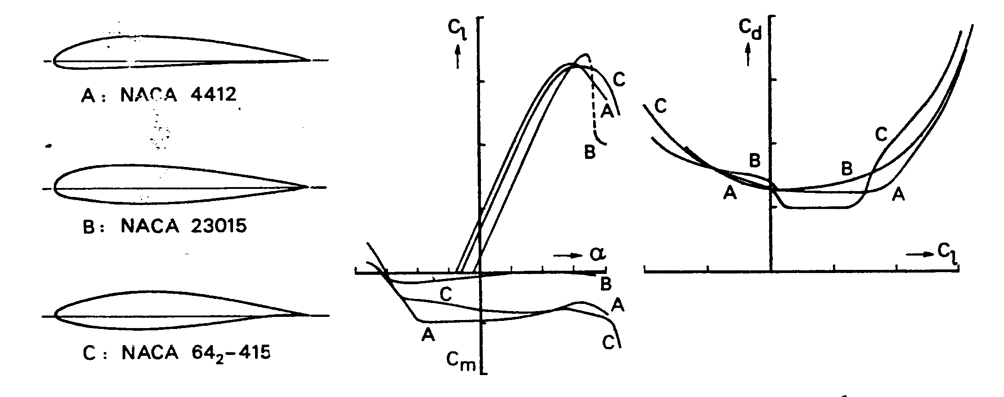
8.2.6 Airfoil Databases & Tools NACA Airfoil Families
Overview of NACA 4, 5 & 6 family
A: NACA 4412
B: NACA 23015
C: NACA 642-415
Notes:
7 & 8 series are supercritical speeds. Maximizing the laminar flow, seldom used as they are inefficient outside of their optimum conditions
What would you choose for a tailless aircraft?

Slide 83
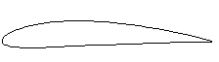
8.2.6 Airfoil Databases & Tools NACA Airfoil Families: NACA 4 (4-digit series)
Example: NACA 4415
c
Maximum camber = 0.04c
Position of maximum camber = 0.4c
Thickness/chord ratio (t/c) = 0.15c
0.15c
0.04c
0.4c
Notes:
See also http://www.aerospaceweb.org/question/airfoils/q0041.shtml for the mathematical relations describing the thickness distribution and camber line definition of NACA airfoils. Find there also a table summarizing advantages, disadvantages and typical application of all the NACA airfoils families (actually only the series 4, 5 and 6 are of interest!)
NACA 4 digits have rather gradual stall behaviour. They features gradual increase in drag and pitch moment for increasing angle of attack. They are good also in (low speed) trainers, which have to operate in many different conditions (not one fixed C_{ldes})
C-5 Galaxy NACA 0012
Fairchild A10 6716 (root) and 6713 tip

Slide 84
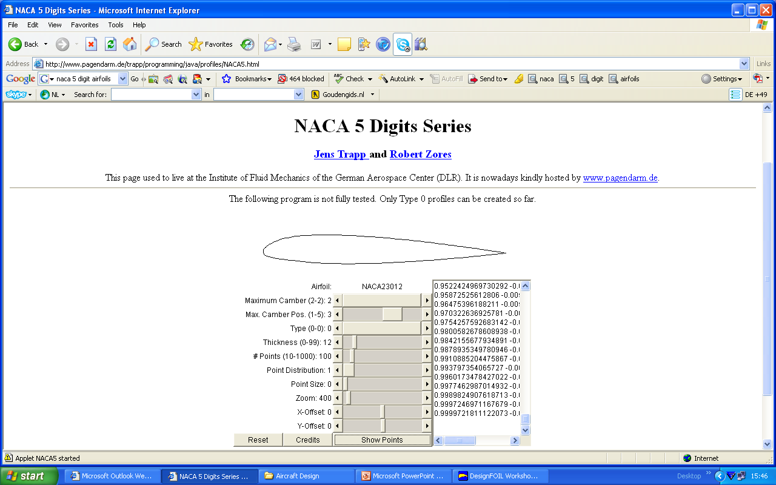
8.2.6 Airfoil Databases & Tools NACA Airfoil Families: NACA 5 (5-digit series)
Example: NACA 23012
c
0.12c
Maximum camber = 0.02c and C_{ldes}= 0.15 * 2
Position of maximum camber = 0.5 * 30c = 0.15c
Thickness/chord ratio (t/c) = 0.12c
0.02c
0.15c
Possibility to select airfoil directly on the base of the required design lift coefficient.
C_{ldes} = first digit times 0.15
Notes:
NACA 5 digits are generally appropriated for personal/utility or regional commuters aircraft (Mcruise < 0.4), with (t/c)_{max} = 14%.
The position of the max camber is closer to the nose with respect to the 4 digit series. They feature high values of C_{lmax} (the highest of all the NACA families) but a rather abrupt stall behaviour. Due to this poor stall behaviour NACA 5 airfoils are quite often used together with NACA 4 airfoils installed at the wing tip. (see next lecture concerning the stall behaviour of wings)
See also http://www.aerospaceweb.org/question/airfoils/q0041.shtml for the mathematical relations describing the thickness distribution and camber line definition of NACA airfoils

Slide 85
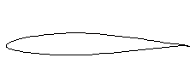
8.2.6 Airfoil Databases & Tools NACA Airfoil Families: NACA 6 (6-digit series)
Example: NACA 64₃ -212
c
Indicate series
Location of maximum pressure in tenth of c = 0.4c
Extent of drag bucket: C_{ldes} ±0.3
Design lift coefficient: C_{ldes} = 0.2 Thickness/chord ratio (t/c) = 0.12c
0.12c
Notes:
F16 NACA 64A204
F22 uses a NACA 6 as well!

Slide 86




8.2.6 Airfoil Databases & Tools Airfoil Calculation Tools
In case you do not have appropriate reference data describing the characteristics of your selected airfoils, you might want to calculate them by yourself¹, making use of some simple panel code.
JavaFOIL * : a shareware panel code available at http://www.mh-aerotools.de/airfoils/javafoil.htm
DesignFOIL ** : a shareware panel code available at http://www.dreesecode.com (It is useful to download also the Airfoils definition archive, available at the same site.)
XFOIL *** : a shareware panel code, developed at MIT and available at http://web.mit.edu/drela/Public/web/xfoil/
Use these tools exclusively for airfoils analysis and NOT for 3D wing design!
Notes:
1) Consider that a lot of the airfoils used on modern aircraft are not those standard (like the NACA) we discussed before. More and more often the airfoils employed on a wing have been developed specifically for that very wing, by means of optimization code and wind tunnel studies. Rarely information of those airfoils becomes available to the public (and potential competitors).
* Completely free Java applet, easy to use and quite robust. All NACA airfoil families are ready available. You can also import airfoils from external sources by copying and pasting the airfoil coordinates inside the given slot. It is also provides a simple tool for airfoil inverse design. It does not allow to plot on the same graph the curves of different airfoils.Directly compute Mcr at varying angle of attack. In the options you can select more languages.
** Note the availability of this software has been recently changed from shareware to commercial. Anyway a demo version can still be dowloaded at the reported HTTP. The demo is valid 30 days, then you are prompted to acquire a licence (though the demo keeps on working). Be aware! The demo tool has some limitations on the modelling of some NACA airfoil families. An older version has been made available on BB with less limitations on NACA 6 airfoils. It can give strange results when Reynolds number are too high!
*** Xfoil, developed by Prof. Drela at MIT is a completely free software tool. The interface is not so intuitive and user friendly as DesignFoil.

Slide 87
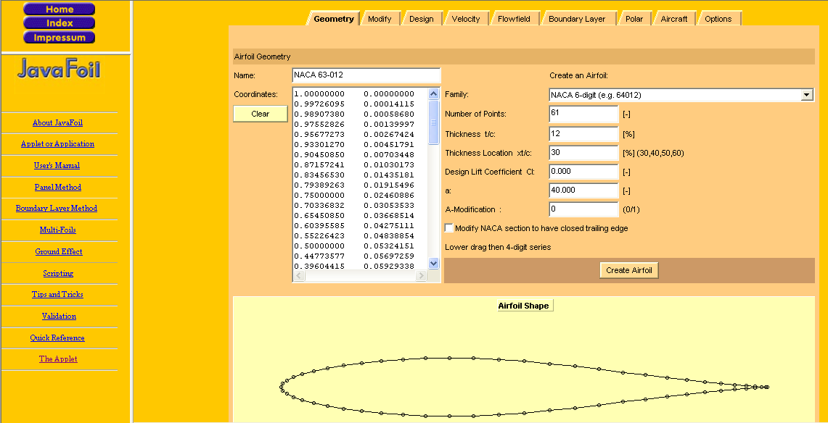
8.2.6 Airfoil Databases & Tools Airfoil Calculation Tools: JavaFoil…. in 3 slides*
Choose your language
Select here your airfoil from a given set of (NACA) airfoil families
Paste here the coordinates of an airfoil defined outside JavaFoil
Notes:
* In any case refer to the manual!

Slide 88
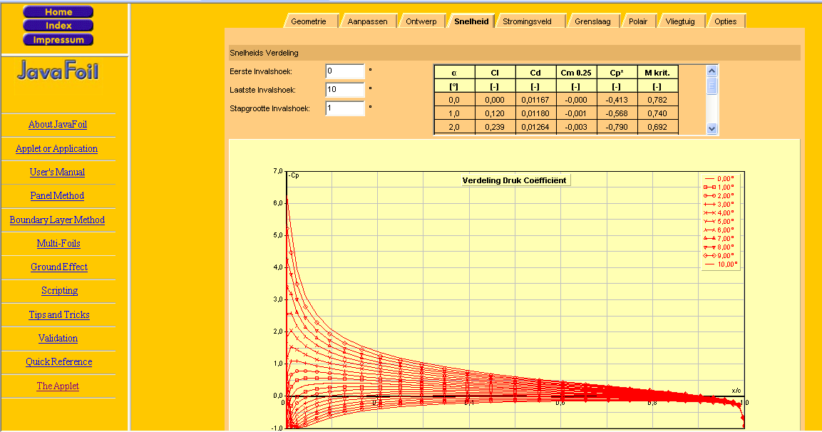
8.2.6 Airfoil Databases & Tools Airfoil Calculation Tools: JavaFoil…. in 3 slides*
To compute speed and Cp distribution
Specify here the range of angles of attack
Read here the suction peak value and the relative Mcr of your airfoil (at the given angle of attack)
Notes:
* In any case refer to the manual!

Slide 89
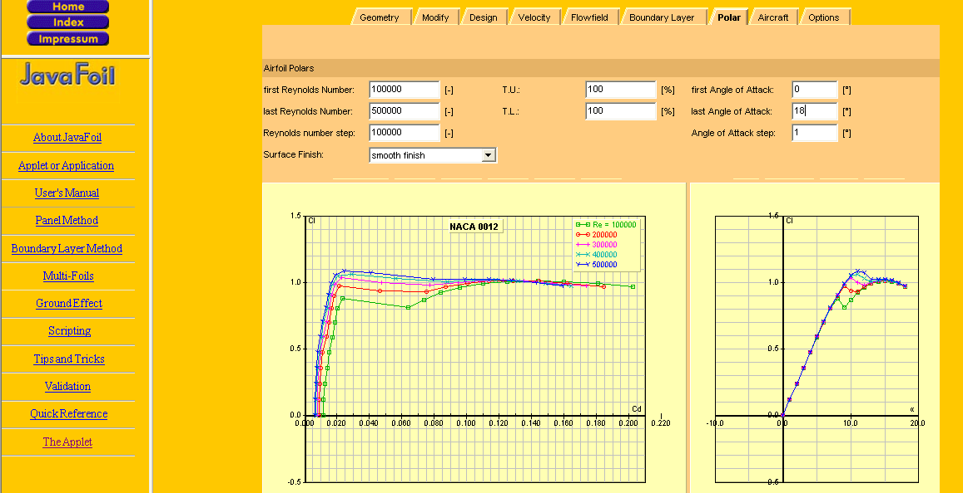
8.2.6 Airfoil Databases & Tools Airfoil Calculation Tools: JavaFoil…. in 3 slides*
To compute lift and moment curves and drag polar
Specify here the range of angles of attack
Specify here the range of Re values
Notes:
* In any case refer to the manual!

Slide 90
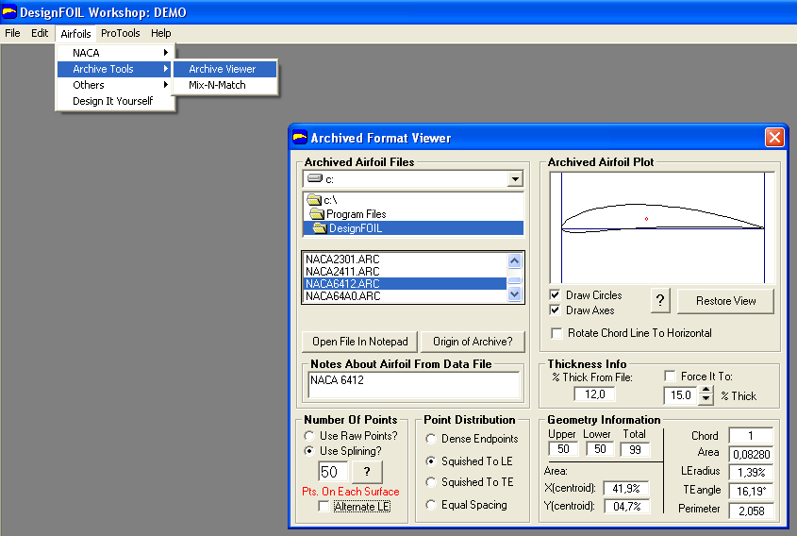
8.2.6 Airfoil Databases & Tools Airfoil Calculation Tools: DesignFoil…. in 3 slides*
Load an airfoil from the archive (you can also add new airfoils to the archive), or interactively define an airfoil yourself, using the provided modelling functionalities
Notes:
* In any case refer to the manual!

Slide 91

8.2.6 Airfoil Databases & Tools Airfoil Calculation Tools: DesignFoil…. in 3 slides*
Read here the value of the minimum pressure coefficient C_{p,0}, to be used for calculating M_{cr}
Use the virtual wind tunnel to compute the airfoil pressure distribution.
Insert the appropriate Reynolds number. Remember Re** varies from cruise to take off & landing conditions
Beware when using the compressibility effect option!* better OFF!
Notes:
*The compressibility effects are accounted here (using the Prandtl compressibility correction), but the tool works only for M<0.75.
In general you have the analytical tools to provide these corrections without using this tool option. Besides, many of the formulas provided in the lecture are already accounting for the compressibility effect, hence do not end up appling the compressibility corrections twice!!!!
Typically you will not need to have the compressibility effects functionality on, especially when the intent is to generate the same kind of data provided in the Abbot’s book (though the Abbott’s polar and lift curves are not computed, but actually gathered in a low speed wind tunnel, hence without any compressibility effect!!!)
**To compute Re you will have to have an estimate of the airfoil chord length. Typically the mean aerodynamic chord (M.A.C.) of the wing is used as average wing chord value! When computing Re for your airfoil, consider that in case of swept wing, you will have to use the effective speed of the flow investing the airfoil, i.e., V∞cosΛ!
Consider that at too high Re values you might get strange unreliable results (odd, broken curves). Ask yourself if you really need to obtain values for such high Re...

Slide 92

8.2.6 Airfoil Databases & Tools Airfoil Calculation Tools: DesignFoil…. in 3 slides*
Use this button to compute lift and moment vs. α and the drag polar (at the selected Re numbers)
Use the CrossHairs function to measure C_{lmax} and α_{stall} on the lift curve
Notes:
Any questions on airfoils

Slide 93
Lecture Contents
Wing Sizing
8.1. Introduction to Wing Design
8.2. Infinite Wings & Airfoils
8.2.1 Characterization and Performance
8.2.2 Selection Procedure
8.3. Finite Wings
8.3.1 Planform Parameters
8.3.2 Effect and selection of wing design parameters
8.3.3 Lift curve for finite wings
8.4. High Lift Devices
8.4.1 Trailing-Edge Devices
8.4.2 Leading-Edge Devices
8.5. Other Considerations
8.5.1 Wing Fuel Tanks
8.5.2 Integration of Wing Structures
8.6. Wing Design Checklist
Notes:
Calculate Mcrit correctly
Made a good assumption on sweep angle
Lift coefficient correctly
Take in account compressibility effects (Prandtl Glauert)
Low drag/drag bucket

Slide 94
Lecture Contents
8.3 Finite Wings
8.3.1. Wing Design Parameters & Definitions (S, Λ, A, λ, ε, i_{w,} Γ)
8.3.2. Effects and Selection of Wing Design Parameters
8.3.2.1. Sweep angle (Λ)
8.3.2.2. Aspect ratio (A)
8.3.2.3. Cantilever ratio
8.3.2.4. Taper ratio (λ)
8.3.2.5. Twist angle (ε)
8.3.2.6. Incidence angle (i_{w})
8.3.2.7. Dihedral angle (Γ)
8.3.3. Lift Curve for Finite Wings (Airfoil Design to Wing Design)
8.3.3.1. Lift Curve Slope for 3D Wing (DATCOM Method)
8.3.3.2. Stall Conditions for the 3D Wing
Notes:
Of course the wing surface S is one of the most important wing parameters! However this has been already discussed and evaluated in the second module of this course.

Slide 95


8.3.1 Wing Design Parameters & Definitions Wing Surface S
Different kinds of wing reference surfaces are used and defined in practice*.
The extended trapezoidal wing surface is the reference wing surface typically used to define the wing lift coefficient.
**
Actual wing planform
Trapezoidal reference wing planform
S/2
Equal area segments
In these examples only half of S is represented!
Notes:
To define the trapezoidal reference surface, eventual chords extensions, root and tip rounding and curvatures are ignored! The extended trapezoidal wing surface is actually called extended, because it extends inside the fuselage, till the aircraft symmetry plane.
It is measured in planform view, hence it is independent from the dihedral angle (until the wing span is also independent from the dihedral angle).
*The wetted area (hence the actual exposed surface of the wing) would seem the most logical surface to be used as reference, rather than the extended trapezoidal one. However, it is quite difficult to compute, in fact, the airfoils’ thickness must also be known to calculate it.
Other typical reference surfaces are the flapped wing reference surface (i.e., the wing area interested by the presence of flaps or slats; defined in 8.4), and the exposed wing surface, which is actually equal to the trapezoidal surface subtracted by the part masked by the fuselage!
Note that the use of different reference surfaces yields to different value of the wing lift coefficient….not to different values of lift!
** Consider that, in assignment 2, you already computed both the optimal wing loading and the maximum take-off weight, hence you already have a value for the wing surface S!

Slide 96
8.3.1 Wing Design Parameters & Definitions Wing Span b, root chord C_{r} and Tip chord C_{t}
Experimental studies on wing-body configurations with different values of b/d, have demonstrated the fuselage gives a lift contribution about the same as the contribution lost by the central part of the wing that is masked by the fuselage.
The span b is defined as the tip-to-tip distance measured on the wing (b < 80m!!)
The root chord is the chord of the trapezoid wing area at the centerline
The tip chord is the chord of the trapezoid wing area at the wing tip
Fuselage of diameter d
This is not the root chord!
C_{r}
C_{t}
Wing span b
Notes:
To operate in common airports (manoeuvre on the ground, approach the terminal areas, enter hangars for maintenance) the maximum span length that is allowed today is 80m. This must be considered as the max value possible for b in your wing design!

Slide 97
8.3.1 Wing Design Parameters & Definitions Aspect Ratio A, Taper Ratio λ
The Aspect Ratio is a measure of wing slenderness:
The Taper ratio (λ = 1 for rectangular wing; λ = 0 for triangular wing):
The Trapezoidal Wing Reference Area S:
Substitution & Rearranging
Notes:
λ = small Lambda
Taper ratio, greater than 1?

Slide 98
8.3.1 Wing Design Parameters & Definitions Sweep Angle Λ
Geometric relations to evaluate the sweep angle for different reference axes:
Note that for any taper ratio other than 1, the sweep at the LE and c/4 will be different!
The leading edge and the quarter chord line (0.25 C) are the two most typical reference axis used to define the sweep angle!
M∞
Λ_{LE}
Λ_{LE}
Λ_{0.25}
M∞ cos Λ_{LE}
A/C Centerline
Leading edge
Quarter chord line
Notes:
Λ=Capital Lambda
The sweep angle as function of the X/C
Sweep changes as we change the taper ratio!
Quarter chord is a good estimation of our center of pressure/aerodynamic center
What number (speed) are we delaying: Mdd
How do we calculate the point at which we lift, our center of pressure? How about we simplify our wing a little more.
How about we take the average of all chords?

Slide 99
8.3.1 Wing Design Parameters & Definitions Mean Aerodynamic Chord MAC
The Mean Aerodynamic Chord (MAC) represents the mean of the wing chord
This is NOT the same as the mean geometric chord! It is similar to the mean geometric chord, in case of rectangular wing (taper = 1), MAC is equal to the root chord (and tip chord).
In case of wing with large chord extensions (kinks), the wing MAC can be calculated as the average of the MAC of the various trapezoidal elements weighted by their area.
Typically, MAC is used as reference length for the calculation of the Reynolds number of the whole wing (e.g., for lift and drag calculations)

Slide 100
8.3.1 Wing Design Parameters & Definitions Mean Aerodynamic Chord MAC
Graphical determination of M.A.C
The Mean Aerodynamic Chord:
The Spanwise Location of the MAC:
Remember the taper ratio:
C_{t}
Aircraft Centerline
TE
0.5 C line
LE
Estimated Aerodynamic center for subsonic aircraft
C_{r}
Notes:
The wing aerodynamic center (i.e., the point where we can consider applied the resultant of the lift forces) is located around 0.25 MAC for subsonic aircraft, at 0.4MAC in case of supersonic aircraft.
NOTE for your design: MAC is very useful to define the preliminary longitudinal positioning of the wing with respect to the fuselage. At the early stages of the design process one may locate the aerodynamic center of the wing at the center of the fuselage constant section or, for aircraft with aft-fuselage-mounted engines, at 60% of constant section (hence a bit after).
Indeed, the wing position with respect to the fuselage is set by stability and control considerations. It requires a detailed weight breakdown and the estimation of the aircraft center of gravity (c.g.).

Slide 101
8.3.2 Effects and Selection of Wing Design Parameters
The following wing design parameters affect the performance of the 3D wing:
Sweep angle (Λ)
Aspect ratio (A)
Cantilever ratio
Taper ratio (λ)
Twist angle (ε)
Incidence angle (i_{w})
Dihedral angle (Γ)

Slide 102
8.3.2 Effects and Selection of Wing Design Parameters 1 – Sweep Angle (Λ)
The sweep angle is mainly used to increase the critical Mach number of wing sections
Sweep reduces effective thickness and delays the drag increase at transonic speeds
The flow speed intersecting 2D wing sections is reduced by a factor cos Λ_{LE}
Sweep angle is sometimes used to affect the position of the aircraft c.g. , when the wing is positioned far after to avoid interfering with the cabin zone
For tailless aircraft, winglets can be used for lateral stability and control.
Higher values of the sweep would increase the forces arm, hence requiring smaller winglets/rudders or just improving their efficiency.
M
Λ_{LE}
Λ_{LE}
M cos Λ_{LE}
Airfoil
Notes:
Typically as straight wing it is intended a wing with the quarter chord line orthogonal to the undisturbed flow direction, i.e. Λ_{0.25c} = 0
Theoretically shocks formation on swept wing is determined not by the actual velocity of the air passing over the wing, but rather by the air velocity in the direction perpendicular to the leading edge of the wing.

Slide 103
8.3.2 Effects and Selection of Wing Design Parameters 1 – Sweep Angle (Λ)
Pros:
Higher speed can be reached, because the critical Mach number results increased: M_{cr_swept} = M_{cr_unswept} /cos Λ_{LE}*
For equal Mach, thicker airfoils can be used (lighter structure, higher fuel capacity)
A swept wing is aeroelastically stabilized and gust tolerant** (Only for positive values of Λ!).
Notes:
The capability of the sweep angle in reducing the local speed on the wing sections is completely independent by its sign. After or forward sweep angle (also of different sign on each wing) would do the same job!
However, the “side effects” for a fore-swept wing would be different:
Improved stall capability and controllability at high angle of attack (aileron in zone free from separated flow)
For oblique wing, better wave drag because of the more favourable volumes distribution (area rules).
Fore-sweep is associated with a complex structural design (Use of properly tailored composite material) to account for the critical coupling of bending and torsional load.
*Due to the 3D effects (see coming slides) the increase in M_{cr} is actually not of a factor cos(Λ_{LE})^-1, but only to circa cos(Λ_{LE})^-1/2!
**The fact that the wing upper bending is associated with nose down rotation of the wing (mostly at the tip of course) is such that a swept wing is more tolerant to gusts: when a sudden lift load is generated by a gust, the torsion of the wing, with consequent lowering of the angle of attack, is such that the amount of extra lift is actually lowered!
FORWARD SWEEP IS ELASTICALLY UNSTABLE

Slide 104
8.3.2 Effects and Selection of Wing Design Parameters 1 – Sweep Angle (Λ)
Cons:
Diminished lift capability: For a section normal to the LE we have: C_{l_swept}= C_{l_unswept}cos Λ_{LE}² *
Due to the increase in tip loading (a peculiarity of swept back wings), outboard sections are working at higher C_{l} (higher Cp crest values), and the local M_{cr} at the tip is reduced.
Tip loading increase and thickening of boundary layer (because of spanwise boundary layer flow) exacerbate the problem of tip stall.
The increase of tip loading demands the use of smaller taper ratio values in order to obtain quasi elliptical distribution. But smaller chords at the tip further anticipate tip stall (local Re is lower, hence local C_{lmax} is lower).
For a given span, the wing structure is longer and heavier because of the increased tip loading. The weight of the wing W_{wing} = f (tan Λ_{LE})²
Excessive sweep make it difficult to accommodate landing gears and reduce effectiveness of high lift devices (hence the use of TE chord extensions at the wing root)

Slide 105
8.3.2 Effects and Selection of Wing Design Parameters 1 – Sweep Angle (Λ)
Spanwise flow does not effect lift generation*, but thickens the boundary layer toward the tip, increasing drag and promoting tip stall
3D Effects on swept wing & limitations of simple sweep theory
There are limitations to the simple sweep theory due to the dominant 3d effects in the first 30% of the exposed wing span and in the last 20%: The presence of the fuselage and the tip effect modify the flow condition locally, such there is a local straightening of the isobar lines. Hence the formation of shocks is likely to happen here!
M
Λ_{LE}
M cos Λ_{LE} = M_{eff}
`
isobars
3D effects
30%
80%
Straightening of the isobars at the root and tip prove that effect of the sweep angle is locally diminished
3D effects
Notes:
* Of course the spanwise flow does not have any effect on the lift generation, because it just flows on a straight surface. On the contrary of the component perpendicular to the LE, it is not forced to deviate around a curved surface, hence it does not accelerate and generate any pressure distribution (i.e. lift).
Increase sweep angle at the tip
Decrease sweep angle at the root
Torenbeek

Slide 106
8.3.2 Effects and Selection of Wing Design Parameters 1 – Sweep Angle (Λ)
Corrective measures to counteract the 3D Effects on swept wing (straightening the isobars):
Use airfoils with max thickness closer to the LE at the root
Use airfoils with max thickness closer to the TE at the tip
Use reverse airfoils with negative camber at the root
Modify the planform by increasing LE sweep at the root
Decrease the chord at the tip
Due to the 3D effects, the increase in M_{cr} by the sweep is not of a factor 1/cosΛ_{LE}, but only of 1/√cosΛ_{LE}!
4
LE kink
1
Fence
5
isobars
30%
80%
2
Notes:
Airfoils with max thickness closer to the nose are typically used at the root (the opposite at the tip) to straighten the isobars. In low wing configurations special thick airfoils with reverse camber and negative angle of attack are also used at the root.
The planform can also be locally modified by increasing the LE sweep angle at the root (including a kink in the leading edge, which is also positive because generate small vortices which reduce the spanwise flow component) and smoothly decreasing the chord length at the tip.

Slide 107
8.3.2 Effects and Selection of Wing Design Parameters 1 – Sweep Angle (Λ)
Sweep angle & tip stall:
Balanced aircraft
Wing tip stalled
L_{wing}
L_{wing}
Longitudinal equilibrium:
L_{tail}
L_{tail}
W
W
Aircraft pitches up (AoA grows further)
Notes:
When the wing tip has stalled the lift force component generated by the wing suddenly decreases (because a smaller part of the wing contributes to the generation of the lift) and
its application point moves towards the aircraft center of gravity (the wing AC moves inboard and forward).
This creates a force imbalance such that the aircraft will tend to descend and pitch up
….hence increasing the wing angle of attack and worsening the stall situation!
Note that at high AOA (close to stall) the tail of the aircraft is actually generating positive lift (due to its increased AoA) and not downward lift as shown. However, the large downwash produced by the wing can lower the effective angle of attack of the tail, hence diminishing its effectiveness in stabilizing the aircraft during such crucial condition.
Now how about root stall?

Slide 108

8.3.2 Effects and Selection of Wing Design Parameters 1 – Sweep Angle (Λ)
Tail-off pitch-up boundaries*
Pitch-up behaviour is highly undesirable!
Some aircraft, upon reaching an AoA close to stall, suddenly increase AoA, further increasing the pitching up until full stall is reached while the aircraft is completely uncontrollable!
The pitch-up tendency of swept wing is such that a proper combinations of wing aspect ratio and sweep angle must be chosen to guarantee stability at (and after) stall conditions
This explains why highly swept wings generally have low aspect ratio values
This is not a design rule, but a check! Use it as to verify your design only!
Notes:
Source: Raymer
* The graph refers to tail-off (or wing alone) configurations pitch up, hence the effect of the tail in recovering from stall is not considered. A properly designed tail (or control canard) allows for larger aspect ratio! (source Raymer). See next slide on the position of the aft tail.

Slide 109

8.3.2 Effects and Selection of Wing Design Parameters 1 – Sweep Angle (Λ) Selection
T-tail configuration aircraft are the most critical with respect to pitch-up effect:
At very high AoA, as present in stall, the low energy wake from the wing and the fuselage blankets the tail reducing its stabilizing capability and also making the control surfaces ineffective (deep stall)!
Larger tail surfaces are typically required to account for the reduced efficiency due to the blanking out by the wing wake
Stick shakers and pushers, together with acoustic alarm systems are now mounted on aircraft to prevent the occurrence of such critical conditions.
Notes:
The DC9 implemented also some “vortilons” under the wing with the intent to increase the flow energy from the wing and delay stall occurrence.
Some military aircraft have electronic controls to limit the angle of attach such to avoid dangerous pitch phenomena, such as the F16 which has a computerized alpha limiter to avoid exceeding 25deg.
See also Torenbeek (pag 51-53) about the deep stall phenomena and positioning of the tail.

Slide 110
8.3.2 Effects and Selection of Wing Design Parameters 1 – Sweep Angle (Λ) Selection
The best way to estimate the required sweep angle value is based on the computation of the wing sections M_{cr}.
Use historical data for a “quick and dirty” estimation of a reasonable sweep angle and as a sanity check of our calculations
In section 8.2.4, the historical trend of wing (t/c)_{max} vs. maximum Mach number was shown. In next slide the picture gets completed by the historical trend of wing sweep angle vs maximum Mach number
Different combinations of sweep angle and wing sections thickness ratio yield to the same M_{cr} value
A more swept wing with thicker airfoils can have the same M_{cr} as a less swept wing with thinner airfoils

Slide 111


8.3.2 Effects and Selection of Wing Design Parameters 1 – Sweep Angle (Λ)
Wing sweep historical trend
F104 (razorblade wing)
MACH LINE
0.4
Notes:
Note that for Mach values below 0.4 there is no (aerodynamic) reason to sweep the wing. As a matter of fact the use of very thin airfoils is a way to keep a 0 sweep even at higher M.
However, lower values of sections’ thickness will limit values for the aspect ratio (in order to stay within acceptable cantilever ratio for the wing structure).
The F104 is an example of the use of very thin wing section (3.4%) in order to reduce the effect of compressibility, rather that recurring to higher values of the sweep (in the order of 50deg as similarly fast aircraft). The leading edges of the Starfighter are so sharp that they used to cover them with special protections to avoid accidents during operations on the ground.
*Remember this is a historical trend and not and analytical relation! Use it together with the trend curve for t/c vs M (see section 8.2.4)

Slide 112

8.3.2 Effects and Selection of Wing Design Parameters 1 – Sweep Angle (Λ)
Notes:
The F104 is an example of the use of very thin wing section (3.4%) in order to reduce the effect of compressibility, rather that recurring to higher values of the sweep (in the order of 50deg as similarly fast aircraft). The leading edges of the Starfighter are so sharp that they used to cover them with special protections to avoid accidents during operations on the ground.
https://en.wikipedia.org/wiki/Lockheed_XF-104_Starfighter#/media/File:Lockheed_XF-104_(modified).jpg

Slide 113
RECALL: 8.2.4 Effects of Flow Characteristics: Compressibility Effects: Airfoil Critical Mach Number
1 - Historical trend of (t/c)max on the main wing of aircraft vs. design Mach number:
t/c=0.15
M=0.8
Notes:
Source: Raymer
Attention: in this picture it is not shown any information concerning wing sweep angle values required to use such thickness values! E.g.,a t/c value of 0.15 is normal for Mach values around 0.8, however NOT for unswept wing!!!
The same data are plotted in fig 4.5. of Corke, nevertheless a different trend curve has been built, which does not show (like in the picture above) the discontinuity in the (t/c) values which do not really go below 12% for design MACH<1, while they are always below 6% for supersonic cruise speed.

Slide 114
RECALL: 8.2.4 Effects of Flow Characteristics: Compressibility Effects: Airfoil Critical Mach Number
2 - Historical trend of (t/c)max on the main wing of aircraft vs. crit. Mach number:
Curves from experimental data (zero lift)
Airfoil M_{cr}
Supercritical
10%
NACA 64₁ XXX
NACA 00XX
(t/c)%
Notes:
Source: Raymer
Note how, for the same value of Mcr, supercritical airfoils can be 10% thicker than conventional airfoils (conventional airfoil thickness ratio times 1.1) which is advantageous in term of weight and space for fuel, landing gear, systems etc. We can also read the graph like this: supercritical airfoils have a higher Mach critical values than other NACA 4, 5, 6 families of the same maximum thickness!
Note also how series 6 airfoils, of the same thickness as NACA series 4 and 5 airfoils, have a far higher Mcr.

Slide 115
8.3.2 Effects and Selection of Wing Design Parameters 1 – Sweep Angle (Λ)
High sweep angle values are required for high speed, but low values are required to have acceptable take off and landing performances, which is conflicting.
An adaptive wing, featuring different configurations for high and low speed flight, could be desirable!
However:
Variable sweep mechanisms come at a weight penalty (19% wing weight increase)
Maintaining stability of the aircraft becomes challenging (c.g. doesn’t change, but a.c. does!
Sweeping the wing back requires the tail to carry very high down-load to keep the aircraft trimmed horizontal
Pumping fuel is a possibility to shift the c.g. backwards
Notes:
F14 Tomcat and Tornado are other examples of variable wing sweep aircraft.
Variable wing sweep configuration: 19% increase in the wing weight (4% in the total aircraft empty weight) due to the complexity of the actuating mechanism and the mass of the pivot and bearing system. The problem with variable sweep angle wing is the capability to maintain the stability of the aircraft when the wing is swept back or forth. The position of the cg changes but not as much as the position of the aircraft aerodynamic center. Sweeping the wing back will require the tail to carry very high down load to keep the aircraft trimmed horizontal.
Pumping fuel is a possibility to shift backwards the center of gravity.

Slide 116



8.3.2 Effects and Selection of Wing Design Parameters 1 – Sweep Angle (Λ)
Examples of variable-sweep aircraft configurations:
X-5 (1951)
F-111
Mig 23
Notes:
F14 Tomcat and Tornado are other examples of variable wing sweep aircraft.
Variable wing sweep configuration: 19% increase in the wing weight (4% in the total aircraft empty weight) due to the complexity of the actuating mechanism and the mass of the pivot and bearing system. The problem with variable sweep angle wing is the capability to maintain the stability of the aircraft when the wing is swept back or forth. The position of the cg changes but not as much as the position of the aircraft aerodynamic center. Sweeping the wing back will require the tail to carry very high down-load to keep the aircraft trimmed horizontal.
Pumping fuel is a possibility to shift backwards the center of gravity.

Slide 117
8.3.2 Effects and Selection of Wing Design Parameters 1 – Sweep Angle (Λ)
V∞
V∞
So far, we assumed airfoils defined perpendicular to the wing LE. Hence we have assumed to design an unswept wing and than rigidly rotate it around a pivoting axis in order to orient its airfoils at an angle with respect to the freestream flow (hence have them invested by a slower flow component than the freestream by a factor cosΛ_{LE}). That is what actually happens with the variable sweep wing aircraft shown in previous slide!
However, it is often industry practice to design a swept wing by shearing the airfoil in parallel planes to the freestream rather than pivoting! In this case the effective flow component does not see the selected airfoil, but a similar one with higher thickness ratio! (actually with the same thickness but shorter chord*). This reduces the effect of sweeping the wing and M_{cr} results enhanced by a smaller factor than 1/cosΛ_{LE}
Airfoil perpendicular to LE
Airfoil parallel to freestream
(t/c)_{perp} > (t/c)_{paral}
Notes:
Hence, once you have selected some airfoil, the effect of the sweep angle on M_{cr} depends on the way you define your swept wing!
* The chord of the wing section perpendicular to the LE (and parallel to the effective component of the freestream velocity) is shorter than the chord of the wing section parallel to the freestream by a factor cosΛ_{LE} !

Slide 118


8.3.2 Effects and Selection of Wing Design Parameters 2 – Aspect ratio (A)
Effect of the finite wing on lift generation:
At the tip of the wing air from the lower side of the wing (at higher pressure) tends to escape to the upper wing surface, where the pressure is much lower
This phenomena locally decreases the lift
In addition, tip vortexes are generated, which propagate downstream and locally affect the airflow velocity
A downwash velocity component w_{i} is generated, which affects the aerodynamic flow around the wing
Notes:
B/Standard Mean Chord
B^2/S

Slide 119
8.3.2 Effects and Selection of Wing Design Parameters 2 – Aspect ratio (A): Effect on Drag
Double Effect of the wing tip vortex generation:
The effective AoA is reduced by the downwash velocity w_{i}, so for the same geometric AoA α, the effective AoA is equal to α_{eff} = α – α_{i}. Therefore, less lift is generated.
The lift force (by definition the component of the aerodynamic forces resultant, orthogonal to the effective freestream) tilts backward by the induced angle α_{i}, hence a drag component is generated. This is the so-called induced drag component D_{i}
D_{i}
L
α_{i}
α
V_{eff}
α_{eff}
W_{i}
α_{i}
V∞
Notes:
Induced Drag, is also addressed as Vortex Drag.

Slide 120

8.3.2 Effects and Selection of Wing Design Parameters 2 – Aspect ratio (A): Effect on Lift
The aspect ratio* (or wing slenderness A or AR) value determines how the 3D effects cause a depart from the 2D aerodynamic flow conditions.
The higher the aspect ratio the more the wing behaves as an infinite wing (approaching of 2D flow)
The effect of the aspect ratio on the lift curve slope will be elaborated on later.
Notes:
The aspect ratio is often indicated in literature with AR.
* As matter of fact is b (the wing span) that determines the impact of the 3D effects. However, it is more convenient to use A, because S is supposed to be constant when discussing about a given aircraft design. We cannot just change b changing also the wing surface S. Indeed, different S values actually correspond to different aircraft designs (hence designs complying to different requirements).

Slide 121

8.3.2 Effects and Selection of Wing Design Parameters 2 – Aspect ratio (A): Effect on Lift
The larger the aspect ratio (the longer b when S is given), the smaller part of the wing is interested by the 3D effects, hence the more similarly the wing behaves to the 2D case (infinite long wing).
C_{Lmax}
A
α_{stall}
Note that lower aspect ratio wings have higher stall angles, but lower C_{Lmax} values
Note that, at zero lift, the effect of the aspect ratio is null
Notes:
Source: Raymer
At very low value of A, the 3D effects are so determinant that actually also the linear behaviour is lost (even if not represented in the schematic figure above)

Slide 122


8.3.2 Effects and Selection of Wing Design Parameters 2 – Aspect ratio (A): Effect on Stall
Tailplanes normally have lower aspect ratio values than the main wing, as we want it to stall at higher AoA than wings.
Canards normally have higher aspect ratios than the main wing, as we want it to stall first and force a reduction of the wing’s AoA
Notes:
Canard to stall FIRST, to avoid pitch up moment
Tail after wing, small A
Canard a higher A
http://images.google.com/imgres?imgurl=http://selair.selkirk.bc.ca/aerodynamics1/Appendix/Aircraft/Graphics/Eurofighter.jpg&imgrefurl=http://selair.selkirk.bc.ca/aerodynamics1/controls/Page2.html&h=220&w=300&sz=7&hl=en&start=4&tbnid=t5RzIbWPPyZNHM:&tbnh=85&tbnw=116&prev=/images%3Fq%3Dcanard%2Baircraft%26svnum%3D10%26hl%3Den%26lr%3D%26rls%3DDVXA,DVXA:2004-51,DVXA:en
http://en.wikipedia.org/wiki/Image:Stabilizer.arp.600pix.jpg

Slide 123



8.3.2 Effects and Selection of Wing Design Parameters 2 – Aspect ratio (A): Induced Drag
A is the best cure against the induced drag component!
From a pure aerodynamics point of view*, the higher A the better
For designs that operate mostly at high value of lift coefficient (e.g., because of low speed and low air density), the only way to obtain reasonable range and endurance performances is by using the highest aspect ratio possible, to reduce the induced drag component.
Predator
U2
Global hawk
Notes:
Also concerning the climb gradient, as you observed in assignment 2, the effect of A is always beneficial: for a given wing loading, less thrust is required in correspondence of higher aspect ratio values.
Note also how higher aspect ratio wings require the pilot to trim the aircraft (for a given CL) at a lower angles of attack. During approach, low values of the angle of attack correspond to a better visibility of the ground by the pilot!
But A is not always positive in terms of other manoeuvrability performances. High aspect ratio values (b values when S is fixed) are typically not good for manoeuvrability, because of the large damping effect of the wing during roll manoeuvre.
The actual limitation to the maximum value of A (hence of b, for a given wing surface) is the structural design of the wing. The longer the wing, the heavier and more expensive the wing structure! (see later the slides on cantilever ratio and wing thickness)

Slide 124

8.3.2 Effects and Selection of Wing Design Parameters 2 – Aspect ratio (A): Induced Drag
Another way of reducing the induced drag component is to make use of winglets*. This has almost the same effect as increasing the aspect ratio of the wing (about as much as tipping down the winglet). Therefore, it is common to define the effective aspect ratio (A_{eff})
A properly designed winglet, for example, yields an effective aspect ratio about 20% higher than the bare wing.
Mostly useful when it is not possible to increase the actual aspect ratio
Aircraft with winglets are sexier!
However, they add to the wing weight and are flutter critical!
Notes:
The actual increase in effective aspect ratio due to the use of winglets is a function of velocity and lift coefficient and depends upon the selected airfoils and relative location, geometry and twist of the wing and winglet. Typically a wing with a high aspect ratio will obtain less improvement by the use of winglets.
The design of a proper winglet requires a lot of CFD computations and many hours of tests in the wind tunnel!
Winglets should only be installed on aircraft, which routinely fly at high altitude and/or large angles of attack (this fits the profile of a long range jet airliner, or a long range corporate jet. Not the profile of most of the general aviation aircraft and military trainers). Elsewhere the additional weight and costs to develop the winglets will not be justified, and the aircraft performance will just be lowered!
*Consider that also external fuel tanks can be located at the tip (typical of military aircraft) can have a contribution in increasing the effective wing aspect ratio. Sometimes also endplates can be used to lower the induced drag.
** When computing the geometric characteristics of the wing, obviously, you must use A and not A_{eff}! A_{eff} is to be used when computing the aerodynamic characteristics of the wing, e.g. for the calculation of the lift and drag coefficients!

Slide 125

8.3.2 Effects and Selection of Wing Design Parameters 2 – Aspect ratio (A): Typical Values
Statistical values for different aircraft categories:
Notes:
Source: Raymer
These values for the aspect ratio can be used just as start guess value (*unless you already assumed a specific value for A, when computing your W/S – T/W optimal point, during assignment 2), before proceeding with a refined estimation.
For propeller aircraft just some average value are provided in the table, while for jet propelled engine there is a relation which correlates aspect ratio and Mach number. As a matter of fact higher Mach numbers correspond to lower aspect ratio values. For high speed flight it easier to generate lift because of the high dynamic pressure values, hence lower lift coefficient are typically necessary (→ lower C_{Di})!

Slide 126
8.3.2 Effects and Selection of Wing Design Parameters 3 – Cantilever ratio
For a given thrust, a higher aspect ratio is favourable to improve the climbing capability of the aircraft (particularly in one engine off condition). This condition often determines the lower margin of A.
Due to the beneficial effect of the aspect ratio on the induced drag, the highest possible value of A (hence of b, when S is given) should be selected, as far as possible/convenient for what concerns the design of the wing structure*!
What is another reason to not have a high value of A?
Notes:
*there might be other reason to keep the aspect ratio below certain values. For example, large aspect ratio might be inconvenient for manoeuvrability. Wing flexibility can also be an issue.

Slide 127
8.3.2 Effects and Selection of Wing Design Parameters 3 – Cantilever ratio
The wing cantilever ratio must result within an acceptable range, and is defined as the ratio between the wing structural semi-span and its maximum root thickness:
For aircraft of various weight category:
Typical cantilever ratios are between 18 and 22
Ratios in excess of 25 are rare and normally associated with braced wing aircraft
Ratios in around 15 are quite common for military trainers due to the high manoeuvre loads
Not a design rule, but a sanity check!
Notes:
The best way to check if the selected combination of airfoil thickness, wing span and sweep angle will allow a feasible structure design, the best option is to perform a structural analysis of the wing. The relevant load cases will have to be selected, a proper structural design will have to be proposed (e.g., spars and ribs, truss structure, sandwich etc..) and material and thicknesses will have to be assumed/computed. If the stresses will be within the allowables then the initial wing design is OK.
That is not be possible within the scope of this course, hence the use of the cantilever ratio as kind of sanity check to judge the selected combination of wing parameters (e.g., wing thickness, span and sweep angle).
Simultaneous high values of sweep and span typically demands high values of the wing root thickness! This can be obtained using thicker airfoils (effect on Mcr should be checked) or by slightly decreasing the taper ratio (the possible negative effect on general wing lift distribution and tip loading should be considered)
Larger values of t/c are beneficial in terms of structural efficiency, hence in terms of Wing structural weight: Statistical equations show that the wing structural weight varies approximately inversely with the square root of the maximum thickness ratio.
Halving (t/c)max will increase the wing weight by about 41%. Being the wing weight about the 15% of the total empty weight, an increase of 6% would occur on the total empty weight of the aircraft. Besides a longer wing is generally more expensive to manufacture.
Very often the airfoils t/c values vary from root to tip. The root airfoil can be up to 20-60% thicker than the tip airfoil. Such thick sections are allowed by the effect of the fuselage. In terms of structural efficiency and available wing volume, this is very beneficial because it is exactly at the root that space is required to accommodate the landing gears. As rule of thumb, such thick airfoils should not be used beyond the 30% of the wing span.

Slide 128

8.3.2 Effects and Selection of Wing Design Parameters 4 – Taper ratio (λ)
The main role of the taper ratio parameter is to affect the spanwise lift distribution
Taper ratio affects:
Lift induced drag (depart from ideal elliptical lift distribution)
Wing structural design (weight)
Wing stall characteristics
Notes:
Low values of taper ratio in combination with high values of the aspect ratio are positive for structural reason but might lead to less effective ailerons due to their relative small chord allowed. Also the local Re at tip is reduced, hence the maximum lift coefficients here are lower than at inboard stations.

Slide 129

8.3.2 Effects and Selection of Wing Design Parameters 4 – Taper ratio (λ): Spanwise Lift
The taper ratio is the main design parameter to control the lift distribution along the wingspan. It must be selected to have a quasi-elliptical or elliptical/triangular lift distribution
Rectangular wings (λ = 1): Easiest to manufacture, but worst for weight
Triangular wings (λ = 0): Best for weight, but have worst stall behavior
Elliptical loading (λ = 0.4): Best for induced drag, it is most difficult to manufacture
λ = 0 (triangular wing)
ELLIPTIC LOADING
λ = 1 (Rectangular wing)
This graph is valid for unswept wing!
Notes:
Most wing with low sweep have taper ratio value in the order of 0.4 – 0.5
Most swept wing have a smaller taper ratio value, about 0.2 – 0.3 (see later the interrelation between sweep angle and taper ratio).
Though a wing of taper ratio 1 would be the easiest to manufacture, there are two main negative effects to consider:
1 tip airfoils with long chords increase the amount of lift generated at the tip, with the effect that the lift resultant shift towards tip → higher wing bending → heavier wing.
2 the excess of lift generated at the tip, will cause a significant deviation from the optimal lift elliptical distribution → higher induced drag (about 7% higher than elliptical distribution)
A taper ratio of 0 (triangular wing) will give a triangular lift distribution, which is positive in terms of reducing the wing weight, but there are two main negative effects to consider:
1 decreasing the taper ratio value demands tip airfoils working at higher lift coefficients (being their chords shorter), hence causing a problem of tip stall (see later on the stall characteristics discussion)! We are not designing delta wings here!
2 the excess of lift generated at the root, will cause a significant deviation from the optimal lift elliptical distribution → higher induced drag
As a matter of fact most jet transport aircraft are designed to have a lift distribution which is an average of triangular and elliptical distribution. The drag penalty associated to the deviation from the elliptical distribution is counterbalanced by the lighter wing structural design!

Slide 130


8.3.2 Effects and Selection of Wing Design Parameters 4 – Taper ratio (λ): (Quasi) Elliptical Lift Distributions
For λ = 0.4* the lift distribution is almost elliptical
The increase in lift induced drag is less than 1% higher than the value associated with the optimal elliptical distribution.....but the manufacturing of such trapezoidal wing is far easier!!
SPITFIRE
λ = 0.4-0.5 gives a quasi-elliptical lift distribution only for unswept wing!
Notes:
(source www.zap16.com)
* This is true ONLY for unswept wings!! See graph next slide.

Slide 131

8.3.2 Effects and Selection of Wing Design Parameters 4 – Taper ratio (λ): Selection
The value of the taper which corresponds to the minimum induced drag depends mainly on the sweep angle of the wing.
An untwisted wing without any taper should have a reverse sweep angle of -22 degrees in order to provide a minimum lift induced drag
Note the λ ≈ 0.4-0.5 for unswept wings
Low taper tends to promote tip stall: lower values than 0.2 should always be avoided, unless for delta wing design.
Notes:
Source Raymer
At 0 sweep, a wing taper value about 0.4 is optimal because recreates the elliptical lift distribution. As rear sweep increases, the spanwise component of flow tends to load the tip airfoils, hence deviating from the elliptical condition. That is why, in order to unload the tip and recreate an elliptical lift distribution, the taper has to be further reduced with increasing after sweep angles!
The down effect of reducing the tip chord is the consequent reduction of the local Reynolds number, hence a decrease of the maximum lift capability of the outboard tip sections and enhance risk of tip stall!

Slide 132

8.3.2 Effects and Selection of Wing Design Parameters 4 – Taper ratio (λ): Effect on Stall Behavior
For the same value of taper, see here the effect of the sweep angle!
Notes:
Spitfire

Slide 133
8.3.2 Effects and Selection of Wing Design Parameters 4 – Taper ratio (λ): Effect on Stall Behavior
That is why you never design pointy wings!

Slide 134
8.3.2 Effects and Selection of Wing Design Parameters 4 – Taper ratio (λ): Wing Stall
Note the effect of taper ratio on reducing the C_{lmax} values toward the tip, because of lowered local Reynolds number.
airfoil C_{lmax}
Wing sectional lift coefficient C_{l}
(C_{lmax}-C_{l} station ≈ 0.1)
Increasing angle of attack
Aircraft centerline
η = Span position of the start of wing stall
70% b/2
Aileron location
b/2
Notes:
The stall of the wing starts in correspondence of those sections which have reached their maximum lift coefficient!
In wings designed for low speed (hence, mostly unswept wings), a first approximation rule to predict at which section the stall will start is: etha = (1- taper_ratio). For taper ratio in the order of 0.4 the stall will start about the 60% of the wing span, which is not a critical stall condition, being the ailerons still in the area of attached flow. N.B.: Such a rule cannot be used in case of high speed wing with significant sweep values!

Slide 135
8.3.2 Effects and Selection of Wing Design Parameters 4 – Taper ratio (λ): Tip Stall
Tip stall:
Local losses of lift and increases of drag are together with sudden rolling of the aircraft. Ailerons generally located near the tip (might) become ineffective!
In aft swept wings tip stall is also associated to dangerous pitch-up tendency, and the design of the tail becomes critical!
Some solutions to prevent tip stall:
Use tip airfoils with gradual stall characteristics and higher C_{lmax}
Moderate the taper ratio to avoid too low Reynolds numbers on the tip airfoils (and thus lower C_{lmax} values)
In case of aft swept wings, use solutions to limit the spanwise component of the flow, which grows the boundary layer at the wing tip (e.g., fences...)
Wing tips rotated nose down (also called washout) to decrease the local AoA of the tip sections.
The most dangerous form of stall!

Slide 136
8.3.2 Effects and Selection of Wing Design Parameters 4 – Taper ratio (λ): Root Stall
Root stall:
Less critical than tip stall in terms of lateral control (ailerons still effective), but since a large amount of lift is generated by the inboard section, the aircraft tends to “fall down”. The separating flow hits the horizontal tail creating (if not too violent) some tail buffeting, which can work as a warning signal for the pilot
The wing downwash will also be reduced, increasing the AoA of the tail, which will generate a corrective pitch down moment
In aft swept wings, root stall is actually associated with a stabilizing nose down movement (the lift resultant moves aft)
A stall initiation about the 40% (from the root) of the semi-span is the least critical

Slide 137

8.3.2 Effects and Selection of Wing Design Parameters 5 – Twist angle (ε)
Wing twist (similarly to taper) is mainly used to affect the wing lift distribution and to achieve the elliptical lift distribution, without an elliptical chord distribution.
Twisting the wing tip sections down (washout) is favourable for wing tip stall.
A wing with washout will tend to stall at the root where the airfoils are working at higher angle of attack than the tip ones. (Maintain lateral control!)
The (Geometric) twist angle ε_{t} is measured between the airfoils’ chords (typically between the root and tip airfoils)
Notes:
In a linearly twisted wing, the rotation of the various wing airfoil is proportional to their spanwise position.

Slide 138

8.3.2 Effects and Selection of Wing Design Parameters 5 – Twist angle (ε)
The aerodynamic twist angle is defined as the angle between the zero-lift angle of an airfoil and another:
In case of different camber airfoils installed at the root and the tip of a wing, the aerodynamic twist is not 0 even if the geometry twist is 0!
In case of only symmetric airfoils aerodynamic and geometric twist are the same.
Generally, twist angles values less than 5 degrees are used, to avoid drag increase when the wing is not operating at C_{Ldesign} (for which the twist has been optimised). -3 degrees is a typical twist angle value to avoid wing tip stall.
4 degrees twist down
(washout)
Notes:
www.aerospaceweb.org

Slide 139
8.3.2 Effects and Selection of Wing Design Parameters 6 – Incidence angle (i_{w})
The wing incidence (i_{w}) is the pitch angle of the wing with respect to the fuselage
Typically it is measured between the wing root chord* and a fuselage longitudinal reference plane (e.g. the fuselage floor)
i_{w} is the mechanical setting of the wing relative to fuselage
This angle is selected such that when the wing is at the incidence angle required by C_{Ldesign} (α_{trim}), the fuselage is not at an angle which makes it difficult for to flight attendants to push food carts!
During cruise the fuselage can be kept slightly nose up to contribute to the lift generation
Angles of wing incidence in the order of 1-2 degrees are typical
Notes:
* In case of twisted wings, the incidence angle should be evaluated with respect to the zero-lift angle of the wing, rather than the root chord

Slide 140


8.3.2 Effects and Selection of Wing Design Parameters 6 – Incidence angle (i_{w})
Notes:
Sources:
C919 (left) https://i.pinimg.com/originals/ba/8d/e5/ba8de5c443874304d60fa59d68d45b86.jpg
B737 -https://i.ytimg.com/vi/y36wite_kXE/maxresdefault.jpg

Slide 141


8.3.2 Effects and Selection of Wing Design Parameters 6 – Incidence angle (i_{w})
The Vought F-8 Crusader has a variable incidence wing to increase lift at low airspeeds reducing the need for the pilots to pitch the nose of the fighter up during approach for landing on aircraft carriers
Notes:
Sources:
www.air-and-space.com
http://www.air-and-space.com/edw98/f8bl.jpg
https://www.youtube.com/watch?v=AWQ7RHVjhrw

Slide 142

8.3.2 Effects and Selection of Wing Design Parameters 7 – Dihedral angle (Γ)
The dihedral angle is the angle of the wing with respect to the horizontal when seen from the front.
Once the wing has been positioned with respect to the fuselage, some dihedral angle values can be selected in order to guarantee e.g. engine ground clearance (typically in low wing)
15 cm clearance
5 degrees
Notes:
15 cm clearance, 5 degree bank angle

Slide 143
8.3.2 Effects and Selection of Wing Design Parameters 7 – Dihedral angle (Γ)
The dihedral angle typically affects the lateral stability characteristics of the aircraft (Dutch Roll). Positive values increase stability.
In case of positive dihedral, the angle of attack on the downward wing increases (the opposite on the upward wing) hence a slight increase of lift is generated (the opposite on the upward wing) yielding a balancing roll moment.
The opposite situation (leading to lateral instability) occurs for negative dihedral values!
Downward wing

Slide 144
8.3.2 Effects and Selection of Wing Design Parameters 7 – Dihedral angle (Γ)
Swept wings feature an intrinsic “dihedral effect”, even for a zero value of the physical dihedral angle:
The velocity component due to the sideslip increases the flow speed (hence the lift) on the downward wing inducing the generation of a stabilizing rolling moment.
The opposite is true for the upward wing
Downward wing

Slide 145
8.3.2 Effects and Selection of Wing Design Parameters 7 – Dihedral angle (Γ)
Different Wing Installation Configurations also induce a “dihedral effect”:
For High Wing: Air flow passing around the fuselage locally increases the angle of attack, inducing roll
This effect can be so high that a negative dihedral angle can be used to make the aircraft easier to roll.
The opposite situation occurs on low wing configuration aircraft.
Notes:
Typical value of the dihedral angle for an unswept wing are:
High wing: 0 – 1 deg.
Mid wing: 2 – 4 deg.
Low wing: 3 – 6 deg.
For swept wing they are generally lower. Actually also negative (exp in high wing configuration). A negative dihedral is called anhedral.
Especially in military aircraft the dihedral angle is selected such to avoid any extra stability effect, just because it is desirable to have the aircraft even more responsive to roll manoeuvres.

Slide 146
8.3.3 Lift Curve for Finite Wings 1 – Linear Conditions: C_{Lα}
A finite wing span causes a reduction of the lift curve slope vs. the 2D lift
The downwash velocity component w_{i} reduces the effective AoA, hence reducing lift
The lift-curve rotates clockwise around the zero lift angle α_{0L}
The question remains: How much does C_{Lα} differ from C_{lα} ?
This depends on 3 main contributions:
Aspect ratio (A)
Compressibility effect (M)
Sweep angle (Λ)
α
Notes:
* C_{Lα} = Typically 2π for incompressible flow!

Slide 147
8.3.3 Lift Curve for Finite Wings 1 – Linear Conditions: C_{Lα}
Generally, it is true that C_{Lα} of a wing built with a certain airfoil is lower than C_{lα} of the given airfoil working at the same angle of attack!
That is always true for untwisted wings of finite length, when airfoil and wing are considered working at the same Mach number!
Generally, C_{Lα} stays below 2π. However, in the specific case of unswept, high aspect ratio wings built with thin airfoil and operating at Mach number close to 1, it is possible that C_{Lα} > 2π as shown in the following plot
Notes:
Generally it is true that C_{Lα} of a wing built with a certain airfoil is lower than C_{lα} of the given airfoil working at the same angle of attack! That is always true for untwisted wings of finite length, when airfoil and wing are considered working at the same Mach number!

Slide 148

8.3.3 Lift Curve for Finite Wings 1 – Linear Conditions: C_{Lα}
5% thickness or less
> 4
Notes:
Generally it is true that C_{Lα} of a wing built with a certain airfoil is lower than C_{lα} of the given airfoil working at the same angle of attack! That is always true for untwisted wings of finite length, when airfoil and wing are considered working at the same Mach number!
Generally C_{Lα} stay also below 2π. However, in the specific case of unswept, high aspect ratio wings built with thin airfoil and operating at mach number close to 1, it is possible that C_{Lα} > 2π as shown in the plot above!

Slide 149
8.3.3 Lift Curve for Finite Wings 1 – Linear Conditions: C_{Lα} Evaluation through DATCOM
The following equation (from the DATCOM Method) accounts for the effect of A, M and Λ. It is accurate up to nearly M=1, for swept wing of both low and high aspect ratio:
→ Note: Units [1/Rad]
η = 0.95
: Airfoil efficiency factor**
Compressibility contrib.
: Prandtl-Glauert compressibility correction factor
Sweep angle contrib.
Λ_{0.5C} : Sweep angle measured at half chord length
Aspect ratio contrib.
Notes:
Obviously, the equation above can be used also in case of uncompressible flow (β = 1). In this case the effect of eventual the sweep angle is still accounted by the term with tan²Λ_{(t/c)max.}
In case of A = ∞ and β = 1, all the terms at the denominator become neglectable compared to A, hence the slope of the curve becomes the same as for the 2D case, i.e. 2π.
Note: In case you are using winglets you can increase A by 20%, which is quite a realistic figure, though the actual increase of the effective aspect ratio really depends on the good design and sizing of the winglet itself.
See how the slope of the wing lift-curve depends just slightly on the kind of airfoils used, via the term η. In the end, also the lift-curve slope of an airfoil is always very close to 2π, whatever the geometry of the airfoil. As discussed later, the type of airfoils selected to build a wing strogly affects the wing maximum lift coefficient.
*Remember to indicate the units!!!! Divide the curve slope value calculated in 1/rad by 57.3 in order to have that in 1/deg.
** Unless you know the airfoil lift gradient as function of Mach from experimental data (i.e., NOT from Javafoil, Xfoil, etc..), then you can use the value 0.95 for a good approximation.

Slide 150

8.3.3 Lift Curve for Finite Wings 1 – Linear Conditions: C_{Lα} Evaluation through DATCOM
The DATCOM method is very accurate until very high Mach numbers (above divergence). Errors in the order of 2- 4% occur for unswept or moderately swept wings (<20 deg)
The graph shows an example variation of lift curve slope w.r.t. Mach number for a specific aircraft:
Effect of A
Notes:
Note how the simple use of the Prandtl-Glauert compressibility factor to correct the lift-curve slope for the wing yields a large overestimation, mainly because it does not account for the effect of the wing aspect ratio.

Slide 151
8.3.3 Lift Curve for Finite Wings 1 – Linear Conditions: C_{Lα} Evaluation through DATCOM
The primary problem of surpassing M_{cr} is not that of losing lift due to flow separation (lift actually keeps on increasing!) but it is the drag that grows too much! Rather than M_{cr}, M_{DD} (Mach of drag divergence) is the speed that must not be reached and surpassed!
Different companies and designers use different definitions of M_{DD}:
Boeing: M_{DD}: 20 counts increase
Douglas: M_{DD}: dC_{D}/dM=0.1
For the assignments, use Raymers definition:
C_{L}
C_{D}
M∞
M_{cr}
M_{DD}
M=1
Notes:
M_{DD} is about 3-4% higher than M_{cr}. This difference can grows to about 5-6% for supercritical airfoils.
M_{DD} can be evaluated as function of M_{cr} and the sweep angle, using the formula proposed by Kroo.
As a matter of fact, many aircraft fly at higher speed than M_{cr}. It means that pockets of supersonic flow might be present on the wing!
The difference is not huge, but it allows to design a wing with a slightly lower sweep angle, or, for the same sweep angle, it allows using slightly thicker airfoils.

Slide 152

8.3.3 Lift Curve for Finite Wings 1 – Linear Conditions: Trim Angle α_{Trim}
α_{trim} is the angle of attack at which the wing has to fly in order to deliver the design lift coefficient C_{Ldes}.
The Mach critical condition on the wing airfoil should be checked accordingly to this angle!
The wing, due to its finite length, has to be set at a higher angle of attack than the airfoil. The lower the lift curve slope the higher the trim angle
Effect of finite aspect ratio
α
Rearranging
Notes:
The lower is the aspect ratio (i.e. the lower is C_{Lα}) and the higher is the C_{Ldes} (i.e. required to fly at lower speed and high altitude) the higher is the AoA at which the aircraft has to be trimmed.
The use of cambered airfoils (negative value of α_{0L} ) allows lower trim angles!
*Note that, when calculating M_{cr} for the wing sections, C_{p0} (see part I of the wing lectures module) should be computed with the airfoil operating at AoA α_{trim}!
** when computing α _{trim} do not confuse CLdes with Cldes! Remember: in case of swept wings C_{ldes} is higher than C_{Ldes} by a factor cosΛ²

Slide 153
8.3.3 Lift Curve for Finite Wings 1 – Linear Conditions: C_{Lα} Evaluation through DATCOM
α_{0L} depends on the camber of the airfoil
It does not change when you go to 3D, unless your wing is built up of different airfoils and/or is twisted and/or is mounted on the fuselage at an angle of incidence
Rearrange
Substitute
For
α
Substitute
This is just a characteristic of the airfoil

Slide 154
8.3.3 Lift Curve for Finite Wings 2 – Stall Conditions: Wing Stall Angle (α_{stall}) & Max. Lift Coeff. (C_{Lmax})
The evaluation of the wing C_{Lmax} is very important because it determines how large the surface of the wing has to be
Ref. the stall speed, and the take off and landing performances calculated in assignment 2
The surface of the wing determines the amount of cruise drag and, as a consequence, the MTOW
We need a good estimation of C_{Lmax} also to understand if high lift devices are needed and how large is their required contribution for take off and landing operations
Unfortunately the estimation of C_{Lmax,} as it is possible to perform during conceptual design, is rather inaccurate. Often flight tests (not even wind tunnel tests!) are required for a proper evaluation!
At given flow conditions, C_{Lmax} is generally* less than C_{lmax}
Notes:
Some few reference values for the maximum lift coefficient of a wing:
Clean wings: 1.2 – 1.5
Wings with flap in the inner part of the wing: 1.6 – 2.0
Wings with regular flap and slats: ≈ 2.4
STOL aircraft: ≈ 3
Wings with large flaps immersed in propwash or jetwash: up to 5
* In case of very sharp airfoil and large values of sweep angle, operating in uncompressible condition C_{Lmax} can exceed C_{lmax}, see later.

Slide 155
8.3.3 Lift Curve for Finite Wings 2 – Stall Conditions: Wing Stall Angle (α_{stall}) & Max. Lift Coeff. (C_{Lmax})
A DATCOM method* is proposed here to compute stall angle and maximum lift coefficient of a finite length wing.
This method accounts for the effect of:
Aspect ratio
Taper ratio
Sweep angle
Airfoil type (sharpness factor)
Compressibility
C_{Lα}
α_{s}
α
Notes:
*See also on Corke (pag 181-190) and Raymer (pag 328 – 333)

Slide 156

8.3.3 Lift Curve for Finite Wings 2 – Stall Conditions
The proposed method uses two different analytical approaches:
High Aspect Ratio Wings (Airfoil character has a strong impact on the wing behavior)
Low Aspect Ratio Wings (3D-effects have a strong impact on the wing behavior)
If with Use the high aspect ratio method
Both approaches depend on the leading edge sharpness parameter ΔY
Notes:
According to the aspect ratio of the wing, two different estimation methods must be used to estimate the CL-alpha curve for the wing.
Both methods are presented here, though the aircraft you got assigned is almost certainly a high aspect ratio (A > 4) aircraft.
In case of low aspect ratio wings, the 3d effects are so large that the characteristics of the airfoil have much less impact on the wing characteristics, than compared with the case of a high aspect ratio wing!

Slide 157



8.3.3 Lift Curve for Finite Wings 2 – Stall Conditions: Leading Edge Sharpness ΔY
The capability of a wing to reach high C_{Lmax} depends strongly on the LE sharpness:
The sharper the LE, the higher the possibility of leading edge vortex generation, increasing C_{Lmax}
The shape of the upper part of the airfoil, near the LE*, is mostly responsible for the formation of these vortexes. Hence, the following LE sharpness parameter (ΔY) has been defined:
IF you know the definition of your airfoil you can compute ΔY by yourself, else:
Notes:
*One could think that the LE radius should be the right parameter to account for the airfoil sharpness, but ΔY is preferred because it accounts for the airfoil camber as well.
The smaller ΔY, the sharper the airfoil LE, the higher C_{lmax}, but only for low aspect ratio wings, or for high aspect ratio wing with moderate to high swept wing. Unswept wings are not significantly affected by the sharpness parameter.

Slide 158


8.3.3 Lift Curve for Finite Wings 2 – Stall Conditions for High Aspect Ratio Wing (C_{Lmax})
To determine the C_{Lmax} of a high AR wing use:
Derive from graph on the right
Wing section characteristic, at M=0.2 (hence no comp. effects!). Use the C_{lmax} value for the right Re number!
This accounts for the effect of Mach number higher than 0.2. When defining the C_{L}-α curve at low speed (e.g., at take off and landing), this term is not relevant (see next slide)
1
2
3
Notes:
Fig. above corresponds to fig 9.9 Corke
*ATT! :When deriving the value of the airfoil C_{lmax}, as required by the method above for computing C_{Lmax} at take off and landing, make sure to use the specific Re for those conditions (i.e. take off and landing and NOT cruise!!!). If you use the wrong Re (e.g. the one for cruise condition) you might overestimate C_{Lmax} and eventually undersize your high lift devices!!
Computing the value of C_{Lmax} at cruise conditions is generally not relevant for your class of aircraft? Why? See note next page

Slide 159

8.3.3 Lift Curve for Finite Wings 2 – Stall Conditions for High Aspect Ratio Wing (C_{Lmax})
Mach number correction for subsonic maximum lift of high aspect ratio wings:
Notes:
* Note that the maximum Mach number in these figures is equal to 0.6! It is extremely rare that you need to know the maximum lift capability of your aircraft at higher speed than that! In approach and take off condition (M about 0.2) you can see that the contribution of this term is actually null. So, do not waste using the graphs above!
Besides, an airliner will never flight M=0.6 (or higher) at its maximum lift coefficient…the aerodynamic loads would tear the wings apart!!!
On the other side this can be of interest for aerobatic and air superiority combat aircraft, as well as for aircraft, which needs to cruise in condition very close to CLmax (e.g. operation at very high altitude). In this case it is interesting to include this contribution. It conservatively be assumed that at Mach higher than 0.6, CLmax is not varying.

Slide 160

8.3.3 Lift Curve for Finite Wings 2 – Stall Conditions for High Aspect Ratio Wing (α_{stall})
To determine the α_{stall} of a high AR wing use:
Calculated in the previous two slides
The wing lift gradient (calculated using DATCOM); Calculate it at the right Mach number!
Known characteristic of the wing section (depends on the section camber***)
Derive from graph on the right (accounts for non-linear effects from vortices)
1
3
4
2
Notes:
Fig above corresponds to fig 9.11 Corke
* When computing the wing characteristics at low speed (e.g., at take off and landing) you cannot use the wing lift gradient computed at cruise Mach number!!!
** this term helps you drawing the curved part of the lift curve. It just guides you positioning C_{Lmax} aside the extension of the linear part of the lift curve! This terms gives you also information about the way your wing reaches stall conditions. Note how unswept sharp airfoil wings and blunt airfoil wings in general (swept and unswept) have their CL increasing linearly almost till stall.
*** note how cambered airfoils, have lower stall angles, because of the negative value of alpha_zero_lift!

Slide 161

8.3.3 Lift Curve for Finite Wings 2 – Stall Conditions for a Low aspect ratio wing (C_{Lmax})
Note the effect of sharp airfoils in increasing C_{Lmax}!
F(C₁, A, β,Λ_{LE)}
Notes:
*Use the right value of M (and β)! Do not use the cruise value when you are computing the low speed lift curve of your aircraft (e.g., at take off and landing!)
Fig 12.12 corresponds to fig 9.12 Corke
Taper ratio/C1 curve corresponds to fig 9.8 Corke

Slide 162

8.3.3 Lift Curve for Finite Wings 2 – Stall Conditions for a Low aspect ratio wing (C_{Lmax})
This term accounts for the compressibility effects on C_{Lmax}
F(C₂, A, M,Λ_{LE)}
Notes:
*Use the right value of M (and β)! Do not use the cruise value when you are computing the low speed lift curve of your aircraft (e.g., at take off and landing!). The curves give appropriate result until Mach = 0.6. Beyond that value you can conservatively assume CLmax to remain constant
Fig 12.12 corresponds to fig 9.12 Corke
Taper ratio/C2 curve “ to fig 9.14 Corke

Slide 163


8.3.3 Lift Curve for Finite Wings 2 – Stall Conditions for Low Aspect Ratio Wing (α_{stall})
Source Raymer
Notes:
Note how delta-alphacLmax depends on Mach number only if the value in the abscissae is larger than 4!
Fig12.14 corresponds to fig 9.15 Corke
Fig 12.15 “ to fig 9.16 Corke
Taper ratio curve/ C2 “ to fig 9.14 Corke

Slide 164
Lecture Contents
Wing Sizing
8.1. Introduction to Wing Design
8.2. Infinite Wings & Airfoils
8.2.1 Characterization and Performance
8.2.2 Selection Procedure
8.3. Finite Wings
8.3.1 Planform Parameters
8.3.2 Effect and selection of wing design parameters
8.3.3 Lift curve for finite wings
8.4. High Lift Devices
8.4.1 Trailing-Edge Devices
8.4.2 Leading-Edge Devices
8.5. Other Considerations
8.5.1 Wing Fuel Tanks
8.5.2 Integration of Wing Structures
8.6. Wing Design Checklist
Notes:
Calculate Mcrit correctly
Made a good assumption on sweep angle
Lift coefficient correctly
Take in account compressibility effects (Prandtl Glauert)
Low drag/drag bucket

Slide 165
8.4 High Lift Devices
Why use high lift devices?
They allow the wing to fulfil both high and low speed requirements: They endow the wing with a kind of adaptive/flexible capability.
However: HL devices add complexity and weight that is carried around during the whole mission!
High Lift Devices resolve the conflict of wing design:
Cruise requirements (speed and low drag):
Small wing surface (hence low drag)
Small camber airfoils (less loaded tail and less drag)
Lift generated with low CL value (to reduce induced drag)
Take off and landing requirements (C_{Lmax}):
High lift coefficient and wing area required because of the low speed
The lower the stall speed the better
Small drag at take-off, but high drag at landing
Pilot visibility issues during approach (you need lift at low AOA)
Notes:
Note that for combat aircraft, manouvrability requirements demand high C_{Lmax} values! That is why combat aircraft often use high lift devices also in other phases than just take off and landing.

Slide 166
8.4 High Lift Devices
Check the value of C_{Lmax} computed for the clean wing (at low speed!) and compare it with the values of C _{L_take-off} and C _{L_landing} values you assumed in assignment 2!
Can you take off and land?
NO → That’s why you need high lift devices!
YES → You do not need high lift devices, but possibly you overestimated your wing surface (too low wing loading), hence your cruise performance is rather low!
Assignment 3:
Notes:
Aircraft flying at very high altitude might have problem of cruise stall. Check that your CLmax in cruise is sufficiently higher than CLdes. If they coincide you will not be able to compute any g-positive manoeuvre. If lower, you cannot fly (you either fly faster, or at a lower altitude, or you must use a large wing)

Slide 167
8.4 High Lift Devices
Classification of high lift devices:
(Passive) lift enhancing devices:
Trailing edge devices to increase camber and wing surface (used to meet target C_{Lmax})
Leading edge devices to prevent flow separation and stall (used to provide margin against stall)
Active lift enhancing devices (for STOL or VTOL requirements):
Use air streams from jet/propeller to energize the boundary layer and prevent separation (internally and externally blown flaps, upper surface blowing and vectored thrust)
Notes:
Remember that this margin is required because you do not want to take off and land at stall risk!
This means the maximum C_{Lmax} generated with HL devices must be higher than the actual C_{Lmax} required to take off and land!
A margin of about 0.1 is generally sufficient.

Slide 168



8.4 High Lift Devices
Examples of high lift devices:
(Passive) lift enhancing devices:
Flaps
Slats
Fences, cuffs, leading edge rakes or extensions, dogtooth edges, vortex generators…
Active lift enhancing devices:
Boundary layer suction (a)
Boundary layer energizing (b)
Active jets (c)
…

Slide 169
8.4 High Lift Devices
Typically, different deflection angles are used during take-off and landing:
During take off, flaps are not fully deployed, reducing drag on take-off
During landing, flaps are fully deployed as the excess of generated drag is not an issue
Assignment 3:
You should consider this when sizing your HL devices. At take-off you need to meet the C_{Lmax} requirement with the devices only partially deployed! Assume C_{Lmax} at take off is about 80% of the C_{Lmax} at landing

Slide 170

8.4.1 Trailing Edge Devices
Trailing edge high lift devices:
Plain flap
Split flap
Slotted flap
Fowler flap
Double-slotted flap
Triple-slotted flap
Working Principle:
The total wing camber is increased
The virtual AoA is slightly increased
The surface of the wing is increased (in case of extensible element)
Boundary layer control (in case of properly designed slots)

Slide 171

8.4.1 Trailing Edge Devices
Effect of Trailing Edge Devices on lift curve:
Increase the lift at a given angle of attack
Do not increase the angle of stall; actually they typically lower it! (promote LE stall).
Increase C_{Lmax}
Energizing effect of the slot on the flow, causes it to stay attached longer
The net effect of extending the wing surface increases the lift slope
Notes:
Note how extending flaps, such as Fowler flaps, increases the wing C_{Lα}.
That is because of the increased wing surface (S’), while C_{L} is still defined with respect to the wing reference surface S.
The slope increase is proportional to the ratio of extended wing surface and basic wing surface S’/S (see later).

Slide 172

8.4.1 Trailing Edge Devices
Typical Arrangement of Trailing Edge Movables:
Notes:
Source Niu

Slide 173



8.4.1 Trailing Edge Devices
Plain flap:
Simple
Typically used in small aircraft or thin wings aircraft where there is not space to store a complex retractable mechanism
The performance is sensitive to the sealing of the hinge. (Same as ailerons and spoilers)
Typical deflection angles
Take off | Landing
20 deg. | 60 deg.
CESSNA 172
Notes:
https://cdn.boldmethod.com/images/learn-to-fly/aircraft-systems/4-types-of-flaps/plain-flap-small.jpg
Pictures from www.Airliners.net

Slide 174


8.4.1 Trailing Edge Devices
Split flap:
Simple as plain flap
Not sensitive to the sealing of the hinge.
High drag, deprecated design no longer used today
Typical deflection angles
Take off | Landing
20 deg. | 60 deg.
DC3

Slide 175

8.4.1 Trailing Edge Devices
Slotted flap:
Uses a slot to energise the boundary layer on the upper surface of the flap
Typically used in small aircraft or thin wings aircraft where there is not space to store a complex retractable mechanism.
Typical deflection angles
Take off | Landing
20 deg. | 40 deg.
CESSNA CITATION
Notes:
Pictures from www.Airliners.net

Slide 176



8.4.1 Trailing Edge Devices
Fowler flap:
The flaps is first extracted and then rotated (increase both in wing surface and camber)
The possibility to simply extend the flap without rotating is often used during take-off, where low drag is important
Often used on outboard sections of commercial aircraft (A310, A320, B767, B777)
Complex but efficient
Typical deflection angles
Take off | Landing
15 deg. | 40 deg.
A320
A320
Notes:
Pictures from www.Airliners.net
Airbus A310 (outboard), A320, A300-600, A300, A340
Boeing 767 (outboard), Boeing 777 (outboard)

Slide 177


8.4.1 Trailing Edge Devices
Fowler flap:
Variations of increasing efficiency and complexity of the Fowler and single slotted flap
vane
Typical deflection angles
Take off | Landing
20 deg. | 50 deg.
vane
B737
B737
Notes:
Pictures from www.Airliners.net
A310 (inboard)
MD-80
MD-11

Slide 178


8.4.1 Trailing Edge Devices
Double-Slotted flap:
Variations of increasing efficiency and complexity of the Fowler and single slotted flap
tab
Typical deflection angles
Take off | Landing
20 deg. | 50 deg.
tab
Fowler flap (outboard)
B777
Notes:
Pictures from www.Airliners.net
A321, B757, B767 (inboard), B777 (inboard)

Slide 179


8.4.1 Trailing Edge Devices
Triple-Slotted flap:
The most efficient but also the most complex version of the fowler flap types.
NOT used anymore due to its weight and complexity
Typical deflection angles
Take off | Landing
20 deg. | 40 deg.
B727
B747
Notes:
Pictures from www.Airliners.net
B727, B737, B747.

Slide 180


8.4.1 Trailing Edge Devices
Ailerons & Spoilers
Ailerons
Spoilers
Outboard Ailerons
Inboard Ailerons
Notes:
Picture from www.Airliners.net
Ailerons are typically located between the 50 and the 90% of the wing span.
An aileron works as a plain flap! The best position for aileron is of course close to the tip, because the large arm allows effective roll control without the need of having large control surfaces. But fast (yet subsonic) aircraft have often both inboard (high speed) and outboard ailerons (low speed).
At high speed the outboard ailerons can be subject to the reversal phenomena, which is associated with elastic deformation of the wing. By diverting the aileron down, the local increase in lift forces the wing to rotate nose down. The extent of such rotation can be such that suddenly the wing section with deflected ailerons can end up in a negative angle of attack condition, hence creating a negative lift!!.
That is why at high speed only the inboard spoilers are used for roll control. In some aircraft outboard ailerons are even locked at high speed! Often, spoilers are used together with the ailerons also at low speed.
However, the main function of the spoilers is actually to “spoil” the wing generated lift. This is used to avoid having the aircraft rebounding after touching the ground during landing. Often the spoilers deploying command is automatically actuated at the rotation of the landing gears wheels.

Slide 181
8.4.1 Trailing Edge Devices
Ailerons are typically located between the 50 and the 90% of the wingspan
An aileron works as a plain flap!
The best position for aileron is close to the tip: a large moment arm allows for small control surfaces
Fast (yet subsonic) aircraft often have both inboard (high speed) and outboard ailerons (low speed)
High Speed Aileron Roll Reversal:
At high airspeed, the outboard ailerons can be subject to the roll-reversal phenomena
This is associated with elastic deformation (bending & twisting) of the wing:
Downward aileron deflection locally increases lift, camber and pitch down moment
This causes the wing to (locally) rotate nose down
This rotation can result in a negative AoA condition, hence creating a negative lift! (resulting behaviour opposite from desired)

Slide 182



8.4.1 Trailing Edge Devices
High Speed Aileron Roll Reversal (right aileron section):
Right aileron
At Low airspeed
At Medium airspeed
At high airspeed (with low stiffness wing)

Slide 183
8.4.1 Trailing Edge Devices
Spoilers are typically located spanwise where the TE flaps are
The main function is to “spoil” the wing generated lift
This is to avoid having the aircraft rebounding / bouncing during landing
Often spoiler deployment is automatic at wheel rotation
Spoilers for roll control:
Often used together with ailerons for roll control at low speed
At high speed only the inboard spoilers are used for roll control
In some aircraft outboard ailerons are even locked at high speed!

Slide 184
8.4.2 Leading-Edge Devices
Leading edge high lift devices:
Leading Edge Slot
Slotted Leading Edge Flap (SLAT)
Krueger Flap
Droop Nose
Strake or Leading Edge Extension (LEX)
Triple-slotted flap
Working Principle: Avoid/postpone flow separation at the leading edge
Move the nose of the wing towards the flow (bring up the stagnation point)
Lower the AoA
Energize the boundary layer on the upper wing surface
Notes:
Generally LE devices affect the curvature of the airfoil only locally, but do not modify substantially the airfoil camber. However, slotted leading edge flaps (SLATS) contribute to increase both the curvature and the surface of the wing.
As a rule of thumb, TE devices are used to meet (almost) the (whole) target C_{Lmax}, while LE devices mainly (not only) provide a margin against stall.

Slide 185
8.4.2 Leading-Edge Devices
Effect of Leading-Edge Devices on lift curve (for devices with moving elements):
The linear part of the curve is extended toward higher a C_{Lmax} and AoA
The whole lift curve slightly shifts toward higher AoA (though the curvature of the profile increases a bit, their main effect is decreasing the AoA)
In case of extensible elements (SLAT), the lift curve slope increases
Energizing effect of the slot on the flow, causes it to stay attached longer
The net effect of extending the wing surface increases the lift slope for SLATs
Notes:
Slotted leading edge flaps (SLATS) contribute to increase both the curvature and the surface of the wing.
Note how slats increase the slope of the CL-alpha curve, because extending forward they actually increase the wing surface. Such slope increase is proportional to the ratio between basic wing surface (S) and the extended wing surface (S’).

Slide 186



8.4.2 Leading-Edge Devices
Leading Edge Slot
Typically used in STOL aircraft
Sometimes the slots are sealed during cruise to reduce drag
Leading edge fixed slot
Notes:
Pictures from www.Airliners.net

Slide 187



8.4.2 Leading-Edge Devices
Slotted Leading-Edge Flap (Slat)
This is the most effective LE high lift device
They increase C_{Lmax} and increase the stall angle
A300
Notes:
Pictures from www.Airliners.net

Slide 188

8.4.2 Leading-Edge Devices
Slotted Leading-Edge Flap (Slat)
Mirage 2000

Slide 189



8.4.2 Leading-Edge Devices
Krueger Flaps
The most common LE high lift devices due to their relatively simple architecture and low complexity
B747
Notes:
Pictures from www.Airliners.net

Slide 190

8.4.2 Leading-Edge Devices
Leading Edge Flap (droop nose)
Notes:
Pictures from www.Airliners.net

Slide 191


8.4.2 Leading-Edge Devices
Leading Edge Extensions
Effective at high AoA (higher than 20 degrees), hence at angles far higher than those typical of takeoff and landing, such as maneuvering conditions
F18
Notes:
Pictures from www.Airliners.net

Slide 192


8.4 High Lift Devices
Design of slotted high lift devices:
The effectiveness of slotted high lift devices depends on fine tuning of various air channels between components
The goal is to maintain high pressure peaks on the upper surface, but at the same time let some high-pressure air from the lower part of the wing pass on the upper part to energize the boundary layer and delay flow separation.
Extensive CFD and wind tunnel tests are required to these complex designs.
Notes:
Source: Niu

Slide 193

8.4 High Lift Devices
Areas of interest concerning “stall management”:
Note that the leading edges are not flapped in proximity of the fuselage (to induce LE stall at root)
Note the use of the TE chord extensions both to accommodate landing gears and to increase flap effectiveness (by lowering the wing sweep locally)
TE are flapped up to the fuselage intersection

Slide 194


8.4 Other High Lift Approaches
Thrust Vectoring
Used to enhance or enable STOL/VTOL Capabilities
Typically used for naval/aircraft carrier operations
A very inefficient method of flight (low propulsive efficiency)
Sea Harrier
X-35
Notes:
Pictures from www.Airliners.net

Slide 195


8.4 Other High Lift Approaches
Externally Blown Flaps (EBF)
Used if C_{Lmax} values beyond 3.5 or 4 are required, considered as limit for conventional high lift devices
Flaps/wing surface may need to be locally covered with steel for high temperature resistance
YC-15
C-17
Notes:
Pictures from www.Airliners.net

Slide 196


8.4 Other High Lift Approaches
Upper Surface Blowing (USB)
Used if C_{Lmax} values beyond 4 are required, considered as limit for conventional high lift devices
Flaps/wing surface needs to be locally covered with steel for high temperature resistance
YC-14
An-72

Slide 197

8.4 Evaluation of the Lift Curve for the Flapped Wing
S_{wf}/S : Ratio between reference wing flapped surface and reference wing surface
The LE flapped area S_{wf_LE} is generally larger than the TE flapped area S_{wf_TE}
The flapped area S_{wf} IS NOT the area of the flap!
You CANNOT have S_{wf} = S due to presence of the fuselage (& ailerons)!
Fuselage
S_{wf_TE}
S_{wf_LE}
Notes:
The area of the flap can be calculated by assuming that flaps have same taper ratio as the wing (quite common), knowing the value of c_{f}/c and deciding at what distance from the fuselage intersection to locate the flaps.

Slide 198
8.4 Evaluation of the Lift Curve for the Flapped Wing
Step 1: Determine the required flapped surface S_{wf} to meet the needed ΔC_{Lmax}
Estimate the flap hinge angle based on of the position of the support spar (the rear spar) used to attach the flaps
clean
See table next slide
flapped
α
Notes:
You can estimate the flap hinge angle value on the base of the position of the support spar (the back spar) used to attach the flaps.
Once a certain type of flaps has been selected and the required value for ΔC_{Lmax} has been estimated, the flapped surface can be estimated.
Rather than guessing a value of Swf/S, you can better solve the equation above computing the necessary Swf/S for a certain ΔC_{lmax} .
If the value of Swf/S result so large that you do not have space anymore for ailerons, then you can increase the chord length of the flap (if you are allowed) and/or change type of flaps.

Slide 199
8.4 Evaluation of the Lift Curve for the Flapped Wing
To determine the required flapped ΔC_{lmax}
Note: ΔC_{lmax} ≠ ΔC_{Lmax}
ΔC_{lmax} values 60-80% of the fully deployed values in the table should be used at take off, to account for the partial deployment of the devices
High lift device | ΔC_{lmax} (fully deployed)
TE devices (flaps)
Plain and split | 0.9
slotted | 1.3
fowler | 1.3 c’/c
Double slotted | 1.6 c’/c
Triple slotted | 1.9 c’/c
LE devices
Fixed slot | 0.2
Leading edge flap | 0.3
Kruger flap | 0.3
Slat | 0.4 c’/c
Notes:
The c’/c value is related to the assumed value of cf/c, the ratio between the length of the flap chord and the airfoil chord. See next slide for the exact relation.
When assuming a value for cf/c, you are somehow deciding also the position of the wing back spar (the spar where flaps are hinged).
Too high values of cf will force you to move the back spar too much forward. You will have to check if enough volume is available for the fuel tanks!
Without considering the reduction of torsion stiffness of the wingbox…

Slide 200


8.4 Evaluation of the Lift Curve for the Flapped Wing
c’/c is dependent on flap type and deflection:
To compute c’/c:
First assume a value of c_{f} (see note previous slide)
Then obtain Δc/ c_{f}, based on deflection angle δ_{f} using this graph (Note that Δc/ c_{f} varies at take off and landing)
The flapped chord c’ is then:
c’= c + Δc

Slide 201
8.4 Evaluation of the Lift Curve for the Flapped Wing
Step 2: Determine the approximate variation of α_{0L} due to TE devices
Δα_{0L} can be assumed to be the same value for various TE devices
clean
= - 15 deg at landing
= - 10 deg at take off
flapped
α

Slide 202
8.4 Evaluation of the Lift Curve for the Flapped Wing
Step 3: Determine the slope of the flapped curve
For TE devices which do not increase the wing surface:
For TE devices which increase the wing surface: Where S’ is the increased wing surface by the extended flap (S’/S >1)
With*
clean
S’
flapped
Deployed flaps
S_{wf}
α
Notes:
To compute S’ you need to know the size of your flaps!
*If we assume for the flaps (or slats) the same taper ratio as the wing, by simple geometric considerations we can approximate: S’/S= 1+Swf/S(c’/c -1).
Concerning the curve part of the flapped lift curve (around the C_{lmax} values, hence in correspondence of the stall angle), for simplicity we can assume the same shape as for the clean wing!

Slide 203
8.4 Evaluation of the Lift Curve for the Flapped Wing
Step 4: Add the contribution of any LE devices
See step 1 and table to compute the LE devices contribution
Consider the increase in lift-curve slope due to the extended wing surface if slats are used no other LE devices increase the wing surface), exactly as explained for the flaps at step 3
Generally, Δα_{0L} associated to LE devices is neglected (only the TE devices are responsible of Δα_{0L} )
clean
flapped
The LE flapped area S_{wf_LE} is generally larger than the TE flapped area S_{wf_TE}
α
Notes:
See step 1 and relative table to compute the LE devices contribution.
Also here you can consider the increase in lift-curve slope due to the extended wing surface if slats are used (no other LE devices increase the wing surface), exactly as explained for the flaps at step 3.
Generally Δα_{0L} associated to LE devices is neglected. As shown in figure above, only the TE devices are responsible of Δα_{0L .}
Note that since the effect of the TE/LE devices depends on their deflection angles, we will get different CL-alpha-flapped curves at take off and landing`.. Typically we have full deflection during landing and about half of these value during takeoff (see typical values indicated in previous slides) in order not to spoil the aerodynamic efficiency of the wing during take off when there are climb gradient requirements to be met.

Slide 204
Lecture Contents
Wing Sizing
8.1. Introduction to Wing Design
8.2. Infinite Wings & Airfoils
8.2.1 Characterization and Performance
8.2.2 Selection Procedure
8.3. Finite Wings
8.3.1 Planform Parameters
8.3.2 Effect and selection of wing design parameters
8.3.3 Lift curve for finite wings
8.4. High Lift Devices
8.4.1 Trailing-Edge Devices
8.4.2 Leading-Edge Devices
8.5. Other Considerations
8.5.1 Wing Fuel Tanks
8.5.2 Integration of Wing Structures
8.6. Wing Design Checklist

Slide 205
8.5.1 Wing Fuel Tanks
Wing fuel tank volume estimation:
Calculate volume between rear (55-70%c) and front spars (10-25%c)
Fuel tanks extend up to 85% of the wingspan
4% of the fuel tank volume is taken up by structure and systems
5% of the fuel tank volume must be left empty to account for fuel expansion
w_{t}
h_{t2}
Front spar
Rear spar
h_{t1}
S₂
S₁
L
h_{r2}
h_{r1}
w_{r}
Notes:
Knowing the span portion of the wing (L) occupied by the fuel tanks, the chord percentages at which the front and last spar are located and the thickness (distribution) of the wing section, it is possible to estimate the volume of the fuel tank. It is important to check if the required fuel to be transported is a critical issue which might demand a wing redesign (increase thickness) or the allocation of extra space to store the fuel necessary for the mission (e.g. wing podded tanks, other fuselage located tanks)

Slide 206


8.5.1 Wing Fuel Tanks
Fuel tank geometry vs. wing load relief for transport aircraft

Slide 207



8.5.1 Wing Fuel Tanks
Fuel tank configurations
Joint Strike Fighter fuel tanks
Concorde

Slide 208



8.5.1 Wing Fuel Tanks
Fuel tank configurations
Boeing 737
Piper Tri-pacer
Dassault 7X
Notes:
https://www.newfoxy.com/wp-content/uploads/2016/10/Aircraft-Fuel-systems-590x315.gif
https://www.researchgate.net/profile/Jacek_Gieras/publication/244989427/figure/fig21/AS:668564759515150@1536409668884/Tu-154M-fuel-tank-configuration-No-1-center-wing-tank-CWT-ie-collector-tank-No.ppm
https://blog.softinway.com/wp-content/uploads/2020/06/Storage-fuel-system-of-a-Boeing-737.png

Slide 209
8.5.2 Wing Structures
Typical wing structures include:
Spars to maintain the bending strength and stiffness
Ribs to maintain the cross-section and transfer twisting moments
Stringers and stiffeners to increase the buckling load capacity of thin panels
Considerations:
Supporting the engines (if wing mounted) and high-lift devices
Support of the landing gear hardpoints (if wing mounted)
Preventing fuel sloshing
Transfer of load to the fuselage

Slide 210
8.5.2 Wing Structures
Movables have the same taper ratio as the wing to have straight spar
The movables need to be attached to the spar
The distance between the front and rear spar is 40-50% of the chord
The rear spar is typically at 60% of the wing chord
A clearance of 10% is maintained with the movable surfaces
TE high lift devices are typically extending for a 30% of the chord
Ailerons are 15-25% of the chord
Notes:
Movables include LE and TE flaps/slats, control surfaces etc.

Slide 211





8.5.2 Wing Structures
DC-8
Trident
DC-9
A300
B737
DC-10
B747
L1011 Tristar

Slide 212

8.5.2 Wing Structures

Slide 213

8.5.2 Wing Structures
The front spar is located at about 15% chord
The rear spar is at 55-60% chord:
Simple plain and split flaps are about 25% of the wing chord
Highly slotted flap systems have flap chords up to 35-40% of the chord
About 5-10% chord between the flap and the rear spar for control system components

Slide 214

8.5.2 Wing Structures

Slide 215

8.5.2 Wing Structures
Typical Spar Configurations:

Slide 216

8.5.2 Wing Structures
Typical rib construction
Ribs typically have lightening holes
Ribs are typically connected to the skin or stringers
Ribs can have “mouse holes” to account for stringers to pass through
Often shims are used to facilitate alignment
Notes:
See Roskam part III for a wide collection of aircraft structural layouts.
https://parnall.net/wp-content/uploads/2019/05/Wing-nose-ribs-in-position.jpg

Slide 217




8.5.2 Wing Structures
Typical rib construction
Notes:
See Roskam part III for a wide collection of aircraft structural layouts.
https://parnall.net/wp-content/uploads/2019/05/Wing-nose-ribs-in-position.jpg
https://www.mscdirect.com/betterMRO/sites/default/files/Aero%20-%20Wing%20Rib%20Component.jpg

Slide 218
Lecture Contents
Wing Sizing
8.1. Introduction to Wing Design
8.2. Infinite Wings & Airfoils
8.2.1 Characterization and Performance
8.2.2 Selection Procedure
8.3. Finite Wings
8.3.1 Planform Parameters
8.3.2 Effect and selection of wing design parameters
8.3.3 Lift curve for finite wings
8.4. High Lift Devices
8.4.1 Trailing-Edge Devices
8.4.2 Leading-Edge Devices
8.5. Other Considerations
8.5.1 Wing Fuel Tanks
8.5.2 Integration of Wing Structures
8.6. Wing Design Checklist

Slide 219
8.6. Wing Design Checklist
Do my airfoils work below Mach drag divergence even when the aircraft is flying at max (dive) speed?
If not, change airfoil type, reduce airfoil thickness, increase sweep angle, …reduce speed, increase wing area to reduce the airfoil required Cl, increase sweep angle
Does my structural design look feasible?
If the cantilever ratio is out of range, increase root thickness (use thicker airfoil at the root, or change the taper ratio in order to have a longer root chord), shorthen the wing span, decrease sweep angle.
Is there enough ground clearance for wing-podded engines/loads?
Increase dihedral angle, increase landing gears length or track
Does my wing show any pitch up tendency?
Change combination of sweep and taper ratio, check tail position, put a limiter on angle of attack

Slide 220
8.6. Wing Design Checklist
What about the stall characteristics?
Use washout (twist the tip airfoils nose-down), increase taper value, reduce sweep. Use different airfoils at tip.
Is my wing operating in cruise at very high CL, too close to stall conditions?
Fly at lower altitude, increase speed, use different airfoils, increase wing surface... don’t use flaps in cruise!! Make sure to use high aspect ratio to reduce induced drag, consider using winglets
Is my lift distribution close enough to the elliptical distribution?
If no and you are aiming for minimum induced drag then adjust the taper ratio value and/or twist adequately the wing. If you are looking for a good compromise between wing weight and induced drag, aim for a more triangular/elliptical distribution. Still use the taper ratio and twist angles as main tuning parameters. Anythime you decrease the taper ratio, check also its combination with the sweep angle value.

Slide 221
8.6. Wing Design Checklist
Can my wing deliver the required C_{Lmax} in take off and landing?
If no, then increase size of high lift devices (cf/c and Sf/S), change type of high lift devices, change type of airfoil, increase wing area to lower CLmax
Is the size of high lift devices compatible with wing size?
If not possible to increase high lift devices area (neither in chord wise direction because moving spars makes structure weak and fuel tank volume insufficient, neither in spanwise area because space required by ailerons) change type of high lift devices, consider the use of high lift devices as ailerons as well*, increase wing surface to lower CLmax, relax the take off and landing performances. Consider chord extensions at the root to limit the negative effect of the sweep angle
Is there enough space for the fuel in the wing?
Move spars, increase wing thickness, move fuel somewhere else

Slide 222
WING DESIGN
AESP 415 – Aircraft Design Part I Basics
Lecture 11
MODULE
4
TOPIC 8
Thank You!
Dr. Wout De Backer
1000 Catawba St, Ste 120
wdbacker@cec.sc.edu

